Slide 1
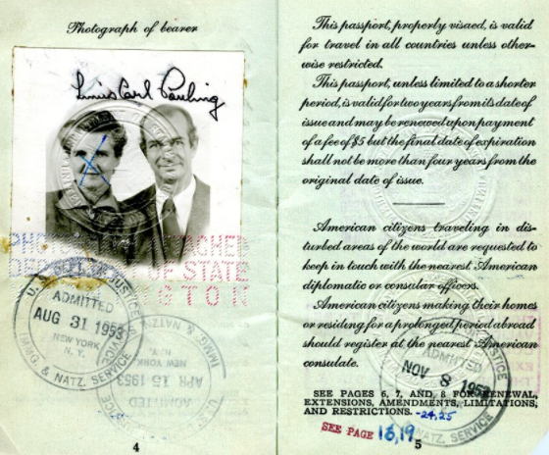
Scientist #Linus_Pauling drew the ire of the FBI, leading to restrictions on his passport.

Slide 2
At least five government agents attended the founding convention of the Communist Party of America in Chicago in 1919 at the behest of #J_Edgar Hoover (right)

Slide 3
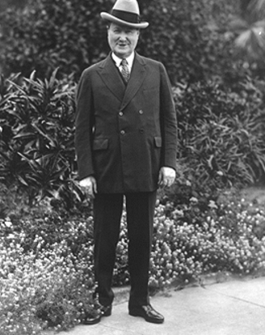
Allan Pinkerton, a scene from the Homestead Strike of 1892, William Burns, the first Bureau of Investigation badge, 1908

Slide 4
Below: rounding up the usual suspects during the 1919 #Palmer_Raids; left: anarchists released from Ellis Island after the raids; Emma Goldman waiting for her deportation; right: #J_Edgar_Hoover and #A_Mitchell_Palmer

Slide 5
Charles Ruthenberg spent most of his communist career being surveyed or imprisoned by the government.

Slide 6
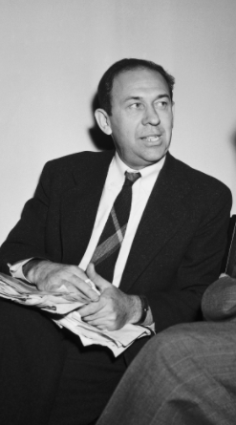
Clockwise from top left: #Whittaker Chambers warned the government about Soviet informers, but to no avail; the Los Alamos Main Gate; informant Theodore Hall, informant Julius Rosenberg and his wife Ethel, Communist spy Steve Nelson

Slide 7
#Kim_Philby and #Elizabeth_Bentley both informed for the Soviet Union, but Philby always stayed loyal to the Soviet cause, Bentley spilled the beans. When she did, Philby helped the KGB shut its US operation down.

Slide 8
By February of 1950 almost all communists had been purged from the US government
Via the #venona code cracking program
Via the Bentley revelations
Via the arrest, execution, and conviction of informers, like Algier Hiss, Harry Dexter White, and Judith Coplon
#Judith_Coplon on the way to her trial

Slide 9
1948: Democratic Party 3-way split
Left to right: Strom Thurmond, Henry Wallace, and Harry Truman split the Democratic Party three ways, so Tom Dewey seemed destined for the White House, but . . .

Slide 10
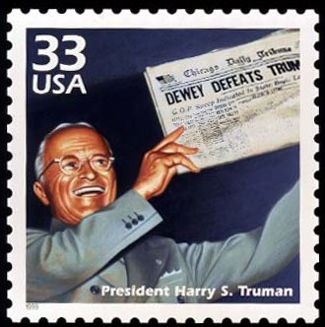
“I have in my hand a list of 205—a list of names that were known to the Secretary of State as being members of the Communist Party . . . ” Joe McCarthy, February 1950

Slide 11
As #Joseph_McCarthy (right) began attacking the CIA, Army, and even Dwight Eisenhower as communist, the national security state turned on him; below, CIA chief #Allen_Dulles

