Slide 1
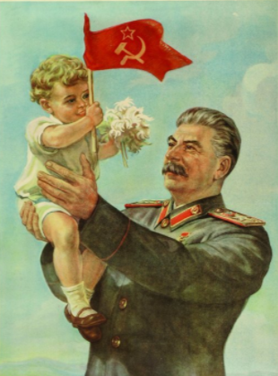
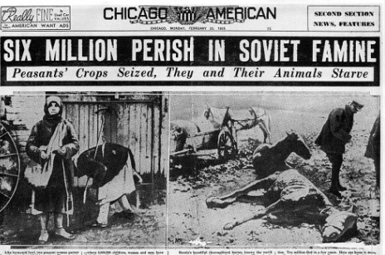
Clockwise: Stalin, friend of babies everywhere; suspected conspirators #Leon_Trotsky and #Georgy_Pyatakov; a scene from the #Purge_Trials of the late 1930s; the Soviet Famine of 1930-31

Slide 2
Stalin’s apologists in the west
“The [purge] trial was conducted fairly and regularly according to the rules of procedure . . . And the defendants were fully guilty of the crimes charged against them and that in the circumstances the sentence was a proper one.” #Dudley_Collard

Slide 3
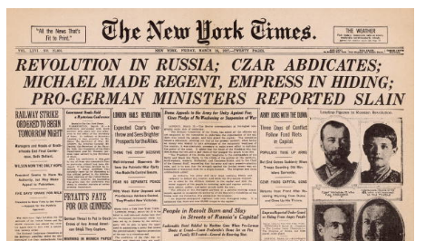
The New York Times reporting on Russian Revolution was “nothing short of a disaster. On the essential questions the net effect was almost always misleading, and misleading news is worse than none at all.”
Walter Lippman and Charles Merz, 1920

Slide 4
#Mission_to_Moscow, the book and movie, 1943; Ambassador #Joseph_E._Davies with a friend

Slide 5
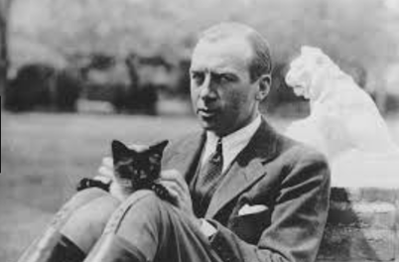
Back door to World War II?
“December 7, 1941, a day that will live in infamy.” – FDR
“He got us in through the back door! – #General_Robert_Wood
The General and his cat.

Slide 6
The New Deal’s new reach
Much more supervision of banking
The regulation of unions
Emergency relief networks
A huge national infrastructure program

Slide 7
The Anti-FDR coalition
In the early 1930s industrialists hostile to the New Deal
In the later 1930 the “America First” movement
Leftists fearful of another civil liberties crackdown like in World War I
Isolationists hostile to immigrants and Europe
Fascist sympathizers

Slide 8
FDR tries to exert more influence on Supreme Court via “court packing scheme” (1937)
He also creates the Executive Office of the President, with a White House Chief of Staff (1939)
Reactions to FDR’s “court packing scheme”

Slide 9
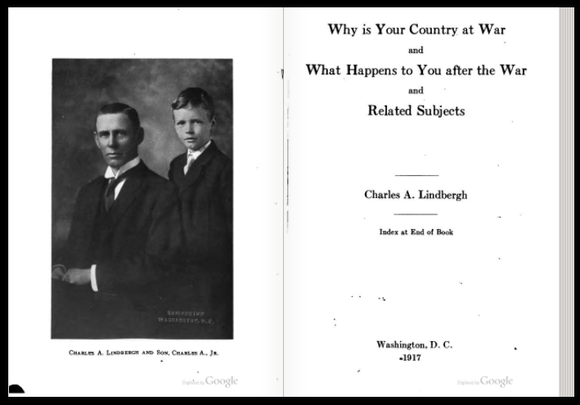
#CharlesLindberghSr, #CharlesLindberghJr

Slide 10
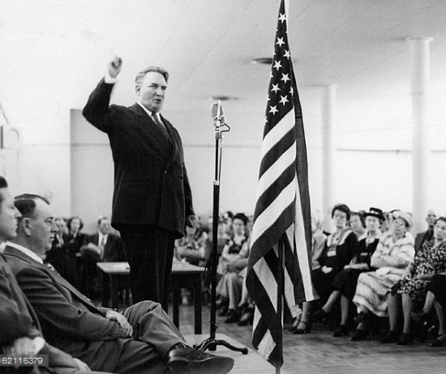
America First’s contradictory cast
Charles Lindbergh Jr. turned a blind eye to fascism; meanwhile the leftist #Almanac_Singers put out an explicitly anti-war album in May of 1941, which they withdrew a month later when Hitler invaded the Soviet Union; by 1942 #Gerald_L.K._Smith (center) had launched his ”Christian Nationalist Crusade”; above, socialist Norman Thomas stuck around until Japan attacked Pearl Harbor

Slide 11
“Their [Jews] greatest danger to this country lies in their large ownership and influence in our motion pictures, our press, our radio, and our government.” - Charles Lindbergh (1941)

Slide 12
The Road to World War II
(1940) Peacetime draft
(1938) Lend Lease
(1941) Troops sent to Greenland and Iceland
(1941) Desegregation of the defense industry

Slide 13
Japan’s empire by 1942

Slide 14
The Road to Pearl Harbor
1940: US issues embargoes on scrap iron, steel, and gasoline to Japan
1940: US moves the HQ of its Pacific fleet from San Diego to Oahu
Military cracks Japan’s diplomatic wireless code with operation “Magic”
1941: FDR issues “freeze” procedures on Japan government assets in USA
Japan begins planning for ”knock out” blow against the USA
US military sends out general warning about possible Japan attack in Pacific

Slide 15
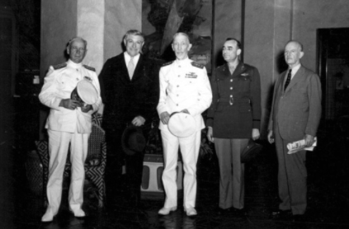
The Roberts Commission on Pearl Harbor (1941)
Led by Supreme Court Justice #Owen_Roberts (second from left) to investigate Pearl Harbor disaster
Commissioners not told about Magic decryption program
Pearl Harbor skeptics #John T. Flynn
and #Harry_Elmer_Barnes

Slide 16
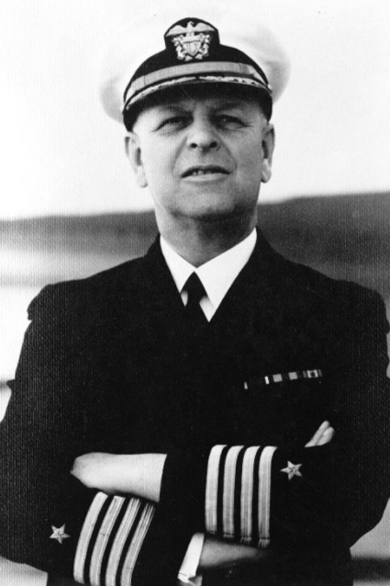
FDR stupidly blamed #Admiral Husband Kimmel and #General Walter Short for Pearl Harbor, which led their allies to accept the conspiracy theories of #Harry Elmer Barnes and #John T. Flynn

Slide 17
By 1944 the Republican party and Presidential candidate Tom Dewey kept struggling with how much to mention the military’s Magic decryption program.

Slide 18
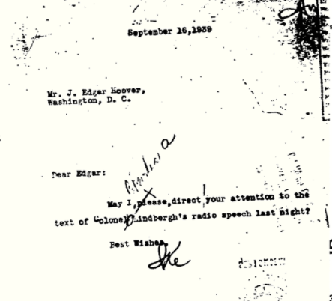
A rivalry between FDR and Charles Lindbergh Jr. turned into a questionable FBI investigation of his politics and a strange persecution of mostly harmless “fascists” during the Second World War.

Slide 19
In 1946 FDR’s prosecution of a small band of misfit fascists was thrown out of court. #Joseph E. McWilliams

Slide 20
FDR did everything except “swimming under the water with his bombs in his teeth.”
John T. Flynn

Slide 21
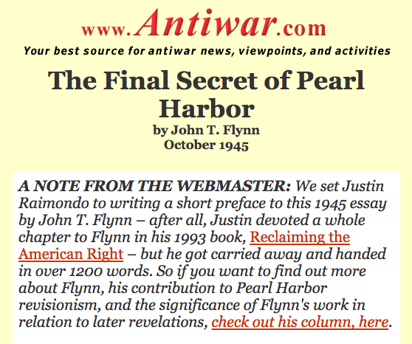
“Old conspiracy theories never die, they just fade away, then fade back in again, then, like, fade away, but, then, you know, come back later in new forms.”
Matthew Lasar, Internationally conspiracy unknown historian

Slide 22
The uses of the “back door to Japan” thesis
Useful to the right as a means to demonize FDR, the New Deal, and the United Nations
Useful to the left as a means to show the extent to which the US will lie to go to war
John T. Flynn testifying against the United Nation, 1945

Slide 23
