Slide 2
#protocolsofeldersofzion

Slide 3
During the First Zionist Conference of 1897 there were supposedly 24 super secret sessions presided over by Theodore Herzl
Who delivered the Protocols more or less the way that Moses brought forth the Ten Commandments
#First_Zionist_Congress

Slide 4
Freemasons and Anti-Masons
Freemasonry started out as a stone maker guild
Then became a fraternal order in the 18th century
Then an object of popular paranoia
In 1832 the US anti-Masonic party won more than 7 percent of the popular vote in the United States
#freemasons, #antimasons

Slide 5
#thejewishperil, #theinternationaljew, #henryford, #biarritz, #mauricejoly

Slide 6
#PriotrRachkovsky, #LordAlfredDouglas, #DavidDuke

Slide 7
“. . . earlier movements felt that they stood for causes and personal types that were still in possession of their country—that they were fending off threats to a still well established way of life in in which they played an important part.
But the modern right wing . . . feels dispossessed: America has been largely taken away from them and their kind, thought they are determined to try to repossess it and to prevent the final destructive act of subversion.” [23]
#RichardHofstadter

Slide 8
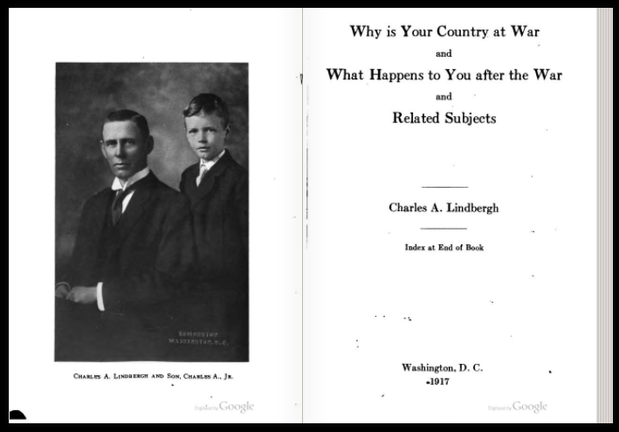
#CharlesLindberghSr, #CharlesLindberghJr

Slide 9
World War I transforms the United States
Federal government takes over the economy
Government creates its own propaganda arm
Passes laws managing and punishing dissent
Directs Americans in almost every aspect of life

Slide 10
Road to World War I
First we were “too proud to fight”
But we weren’t too proud to invade Mexico . . .
. . . and Haiti . . .
. . . and lend $$ for war to Britain and France . . .
. . . or wink while Americans travelled on belligerent ships.

Slide 11
Case for US intervention
US repeatedly attacked
Freedom of the seas needed
France, Britain and Russia moving towards more democratic model
Victory would create new, more democratic international order
#Lusitania, #ZimmermanTelegraph, #UBoats

Slide 12
Millions of Americans opposed US intervention in World War I
German-Americans
Irish-Americans
Socialists
Pacifists
Progressives
Old populists and agrarian radicals

Slide 13
U.S. trade with Europe during the First World War
With the Central Powers (Germany and Austro-Hungarian empire): 1914: 169 million dollars 1916: down to 1 million dollars
With the Allies (England, France): 1914: 825 million dollars 1916: up 3 thousand million dollars! (otherwise known as 3 billion)

Slide 14
“We are going to war at the command of gold. I feel that we are about to put the dollar sign on the American flag.”
Senator George Norris of Nebraska
#George_Norris

Slide 15
The Committee for Public Information
Founded April 13, 1917
Massive pro-War propaganda directed as US population and media

Slide 16
German = Hun

Slide 17
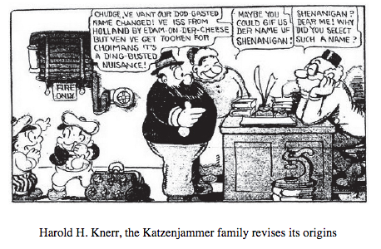

Slide 18
The Espionage Act of June 15, 1917
“Whoever, when the United States is at war, shall willfully make or convey false reports or false statements with intent to interfere with the operation or success of the military . . . [etc] shall be punished by a fine of not more than $10,000 or imprisonment of not more than 20 years, or both . . . “

Slide 19
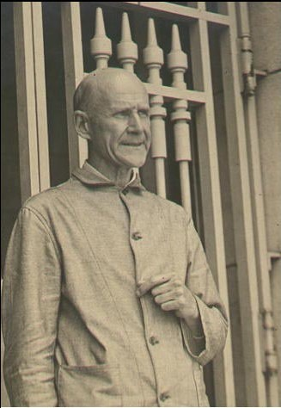
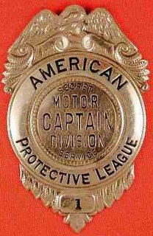
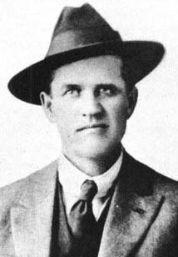
American Protective League badge, Eugene Debs, Frank Little

Slide 20
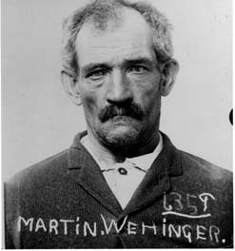
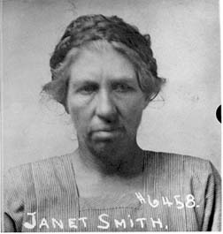
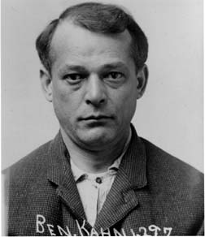
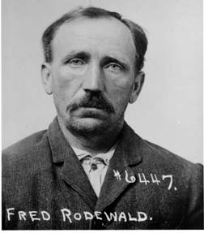
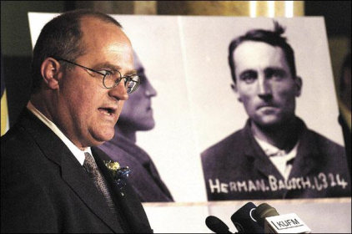
Sedition panic in Montana www.seditionproject.net
79 people incarcerated for “sedition” – 1917-1919

Slide 21
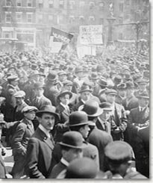
Schenck vs. United States, 1919
Charles Schenck caught circulating leaflets opposing the draft.
Supreme Court declares that in wartime there are different First Amendment rules than in peacetime.
"Words which, ordinarily and in many places, would be within the freedom of speech protected by the First Amendment may become subject to prohibition when of such a nature and used in such circumstances as to create a clear and present danger that they will bring about the substantive evils which Congress has a right to prevent. The character of every act depends upon the circumstances in which it is done.“ –Oliver Wendell Holmes

Slide 22
“Never before had American citizens realized how thoroughly a modern government could impose its ideas on a whole nation.” #Charles_Beard
#Eugene_Debs in prison for opposing US involvement in the First World War

Slide 23
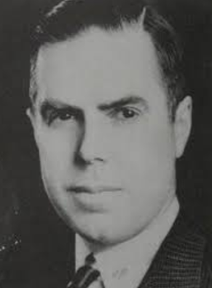
“We did not actually go into the World War to protect ourselves from imminent German invasion or to make the world safe for democracy, but to protect our investments in Allied bonds.” – Harry Elmer Barnes

Slide 24
Woodrow Wilson’s gatekeepers
Below: #Colonel_Edward_House; #Walter_Hines_Page; above: House with Woodrow and Edith Wilson

Slide 25
Post World War I conspiracy hunters
From left: #Dorothy_Detzer at the #Nye Committee hearings, assisted by #Algier_Hiss

Slide 26
The Nye Committee could not prove . . .
a direct link between banks and Wilson
that British banks had influenced US newspapers
that Wilson had been lobbied to relax overseas loan restrictions
that banks had manipulated currency to cause a British financial crisis
Nye confronting J.P. Morgan Jr.

Slide 27
But the Nye Committee did . . .
expose how dishonest Woodrow Wilson had been about the war
and led to the Neutrality Acts of the mid-1930s
which restricted US financial involvement with belligerent nations.
Senator Gerald Nye speaking out against US involvement in World War II

Slide 28
And the Nye Committee . . .
Deluded a generation into believing that wars are just about money.
Henry Ford receiving the Grand Cross of the German Eagle from Nazi officials, 1938.

