Slide 1
Your final examination will take place on Tuesday, June 12 @ 4:00–7:00 p.m.
It will consist of a blue book essay that tests your familiarity with the basic arguments of your six course authors about conspiracy theories: Sunstein/Vermeule, Hofstadter, Walker, Olmsted, and Aaronovitch.
So be sure to review Sunstein/Vermeule’s entire essay, Hofstadter’s “Paranoid Style” essay, the introductions to Walker and Olmsted, and the last chapter of Aaronovitch (“Bedtime Story”). Anticipate an essay question that asks you to compare and contrast these variant ideas.

Slide 2
The essay question will also list four identifications and ask you to use them as examples in your essay. Here are the possible IDs. For studying purposes treat them as you would our regular course IDS:
Dark Alliance Deep Throat Jersey Girls Magic Bullet Mae Brussell MIHOP MKULTRA Operation Northwoods Project Mogul Mulder and Scully The Enterprise
I anticipate that eight to ten pages of a blue book will suffice for your essay answer (in other words, bring a blue book!).

Slide 3
Should the government, like, DO something about conspiracy theories?
The best response would be to engage in “cognitive infiltration of extremist groups.”
Cass Sunstein and Adrian Vermeule

Slide 4
Conspiracy theories suffer from “crippled epistemologies”
Epistemology = the study of knowledge
How do we know what we know?
CTs come out of “self sealing” discussions, immune to other viewpoints
There are benign and harmful conspiracy theories

Slide 5
The Great Depression: a perfect economic storm
Farmers over-borrowed during World War I
The Treaty of Versailles weakened Germany and hurt world economy
Over-production and under-consumption undermined USA
Unregulated banks undermined the system
Why consider the complexities when you can just blame the Great Depression on J.P. Morgan?

Slide 6
Conspiracy theorists aren’t crazy
They just severely limit the range of information they are willing to accept
Karl Popper: They take big events and blame them on small groups of people
Refuse to accept the possibility of coincidence
Is your TV set listening to you? Could be!

Slide 7
Conspiracy theorists operate via rumors, speculation, and ”cascades”
Rapid fire speculation via pay sites, online video, podcasts, Twitter, Facebook, and other social media
Communities adopt conspiracy theories and make it difficult for peers to challenge them

Slide 8
A conspiracy spreads if the advocate is famous
If the group that adopts it is polarized . . .
. . . And devolves into a bubble.

Slide 9
What to do?
The government could ban conspiracy theories.
The government could put a tax on conspiracy theories.

Slide 10
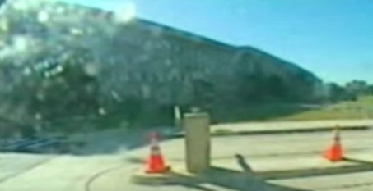
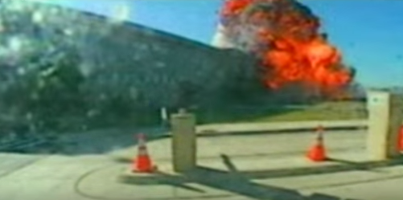
Counter-speech
Release more government information that might discredit conspiracy theories
In 2006 the Pentagon released video of Flight 77 hitting the Pentagon

Slide 11
Interventions
“Government agents (and their allies) might enter chat rooms, online social networks, or even real-space groups and attempt to undermine percolating conspiracy theories by raising doubts about their factual premises, causal logic or implications for political action.”

Slide 12
Richard Hofstadter
One of the “consensus” historians
Identified the “paranoid style” as taking paranoia from personal to national terms
Paranoid Style sees the conspiracy as the “motive force” of history
RH saw conspiracy movements as motivated by the “status anxieties” of their participants

Slide 13
“This must be the product of a great conspiracy, a conspiracy on a scale so immense as to dwarf any previous such venture in the history of man.” #Joe_McCarthy, 1951
“The distinguishing thing about the paranoid style is not that its exponents see conspiracies or plots here or there in history, but that they regard a ‘vast’ or ‘gigantic’ conspiracy as the motive force in historical events.” #Richard_Hoftstadter, 1952

Slide 14
Hofstadter notes that #anti-Masonry and #anti-Catholicism preoccupied much of 19th-century American politics
But these movements saw outsiders as a threat to their society and governmnt

Slide 15
Hofstadter:
Conspiracy theorists from World War I era onward saw government as captured by outsiders: such as banks or communists

Slide 16
Left to right: #Dwight_Eisenhower, #Robert_Welch, #Joseph_McCarthy
“Eisenhower is a dedicated, conscious agent of the Communist Conspiracy . . . “ #Robert_Welch

Slide 17
Kathryn S. Olmsted
Americans have been historically right to be suspicious of their government
The US government has a long history of spying and conspiring against Americans
The US government has a history of promulgating its own conspiracy theories

Slide 18
#Project MKUltra, #Tuskegee Experiment

Slide 19
Jesse Walker
“In America, it is always paranoid time.”
There is no “fringe.” Conspiracy theories are central to American politics and society
The Five Primal Myths
The Enemy Outside
The Enemy Within
The Enemy Above
The Enemy Below
The Benevolent Conspiracy
“Everybody wants to get into the act!’” – Jimmy Durante

Slide 20
David Aaronovitch
Conspiracies are “history for losers”
They tend to overestimate the power of the conspirator
They tend to validate the status quo
Tend to come from educated elites

