Slide 1
Greensboro, February 1960
Black students ask for service at white’s only lunch counters and refuse to leave.

Slide 2
The 14th Amendment of the United States Constitution, 1868
Section 1. . . . No State shall make or enforce any law which shall abridge the privileges or immunities of citizens of the United States; nor shall any State deprive any person of life, liberty, or property, without due process of law; nor deny to any person within its jurisdiction the equal protection of the laws.

Slide 3
The Civil Rights Act of 1875
Be it enacted, That all persons within the jurisdiction of the United States shall be entitled to the full and equal enjoyment of the accommodations, advantages, facilities, and privileges of inns, public conveyances on land or water, theaters, and other places of public amusement . . .
Political cartoon by Thomas Nast

Slide 4
The Civil Rights Cases, 1883 – Supreme Court declares private facilities beyond jurisdiction of the 14th Amendment
Plessy v. Ferguson, 1896 – Supreme Court upholds “separate but equal” segregation

Slide 5
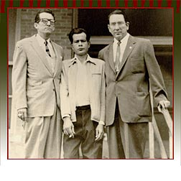
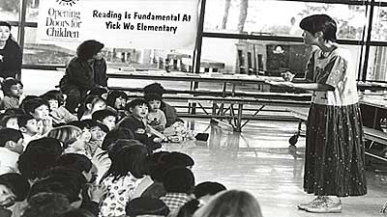
Hernandez v. State of Texas, (1954)
Pete Hernandez found guilty of murder by an all white jury in Texas
The county in which he was tried had not seated a Mexican-American in 25 years
Yick Wo v. Hopkins (1886) became one of the sleeper cases of the late 19th-century; left: Yick Wo elementary school in San Francisco

Slide 6
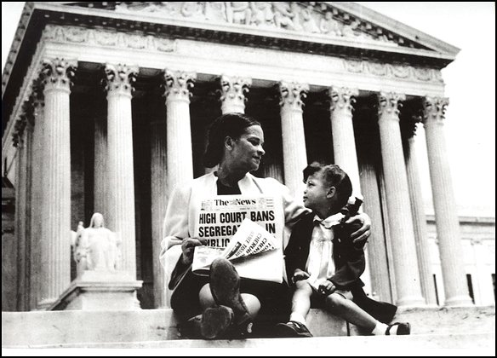
Brown versus Board of Education, 1954

Slide 8
The Baby Boom . . .

Slide 9
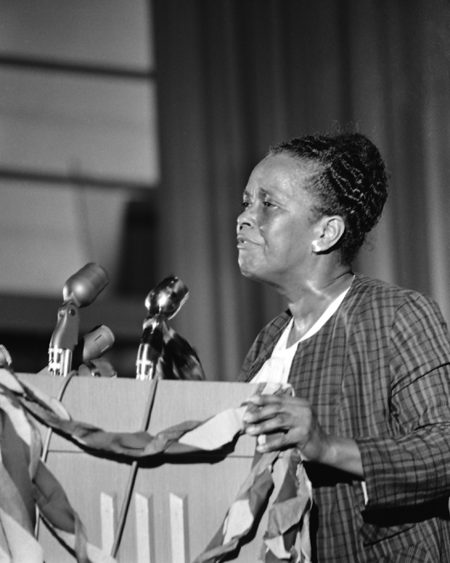
Civil Rights Organizations in the early 1960s
National Association for the Advancement of Colored People (NAACP)
The Congress of Racial Equality (CORE)
The Southern Christian Leadership Conference (SCLC)
“This crusade has to be for more than a hamburger.”
-- Ella Baker of the SCLC

Slide 10
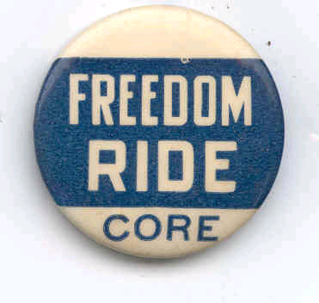
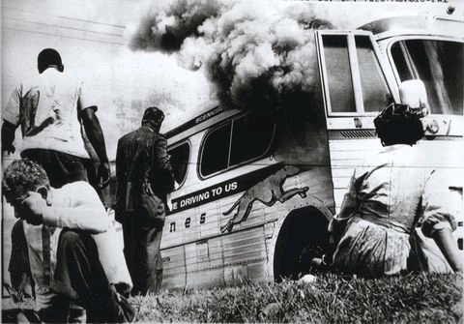
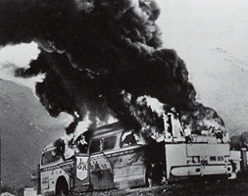
Freedom Riders in Aniston, Alabama

Slide 11
Voter registration in Mississippi, 1962
Robert Moses of the Student Nonviolent Coordinating Committee (SNCC) on the extreme right

Slide 12
1960 anti-HUAC riots in San Francisco
“If you think I will cooperate with this pack of Judases, you are insane.” HUAC witness Bill Mandel, 1960

Slide 13
The Port Huron Statement of SDS, 1962
Called for the democratization of all aspects of American life, including:
Education
Work
Consumption, and
State, local, and national politics

Slide 14
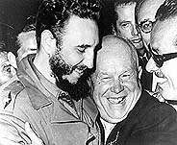
The Bay of Pigs invasion, 1961; Cuban Missile Crisis, 1962
Adlai Stevenson confronting Russians at UN, 1962
Kennedy on TV threatening nuclear war

Slide 15
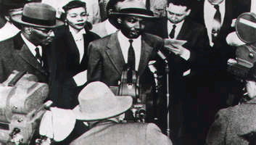
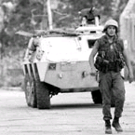
King’s civil rights strategy
black and white protestors bare their throats in the South
whites respond with vicious violence
media rushes to the scene
northern public opinion explodes
the president is forced to bring in federal protection

Slide 16
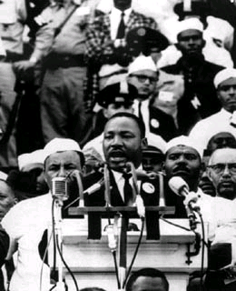
August 28, 1963: The March on Washington
“Where is our party? Where is the political party that will make it unnecessary to March on Washington?”
--John Lewis, 1963

Slide 17
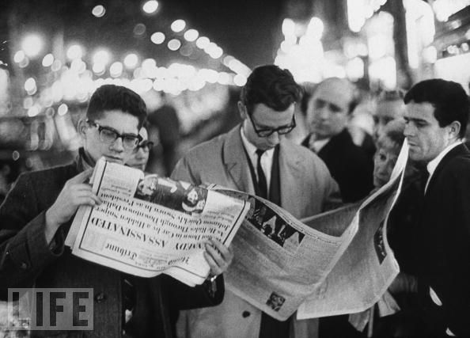
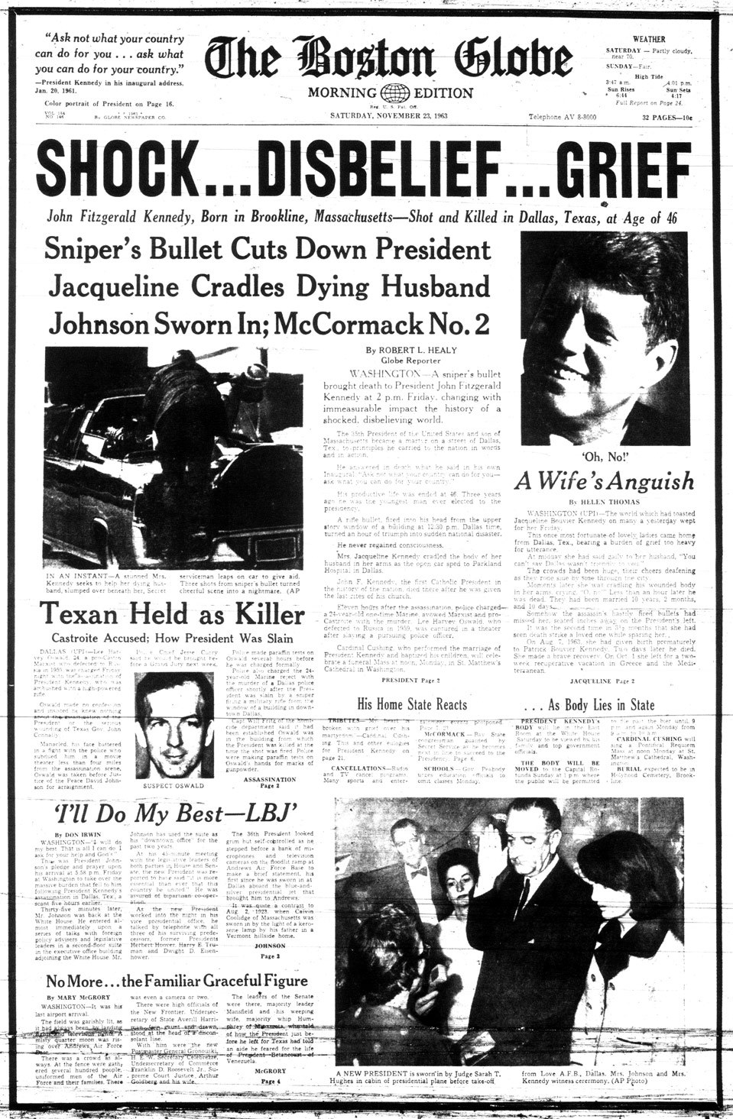
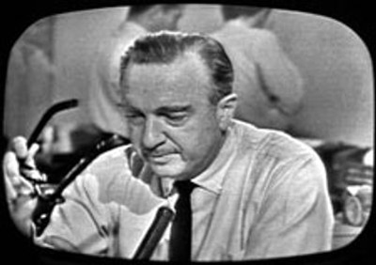
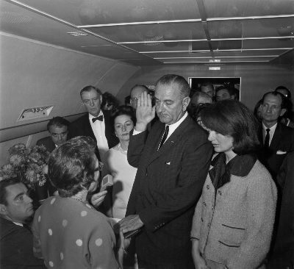

Slide 18
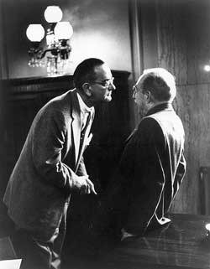
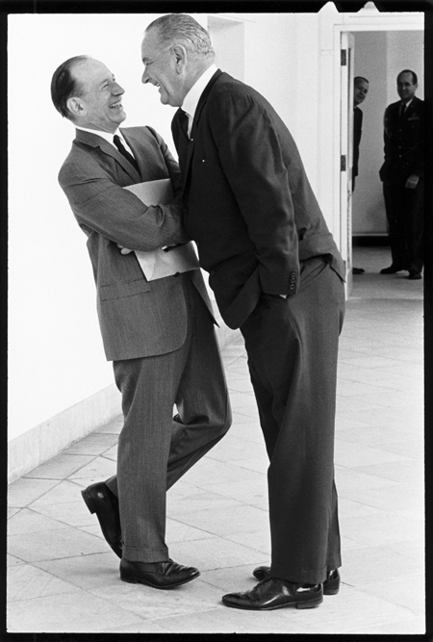
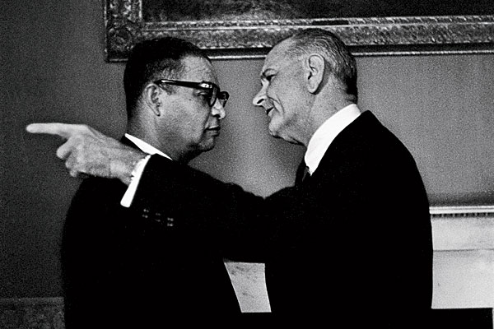
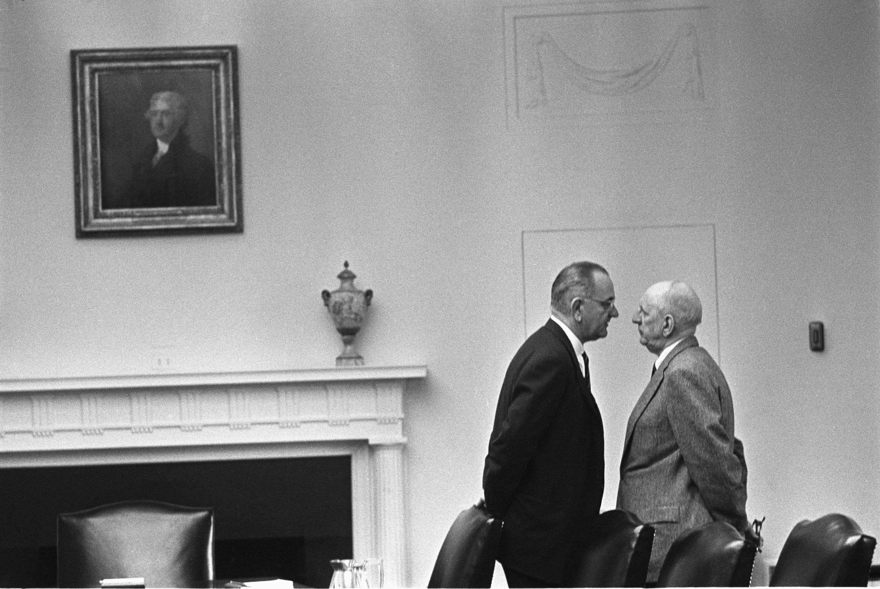

Slide 19
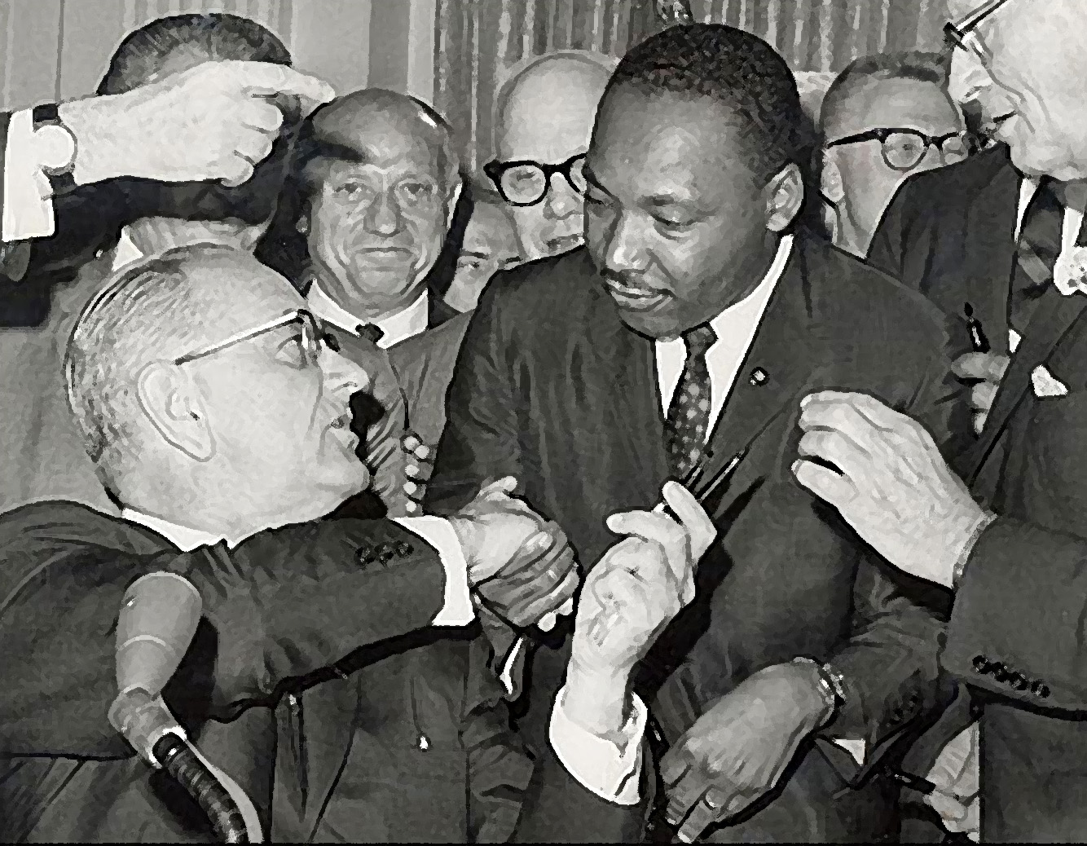
the civil rights act of 1964
Bans discrimination in voting and public places

Slide 20
Mississippi Summer, 1964

Slide 21
Mississippi Summer, 1964
Ivy league students come south to help Mississippi black citizens register to vote
Trained in non-violence tactics by SNCC
SNCC creates the Mississippi Freedom Democratic Party
Civil rights activist Fanny Lou Hamer

Slide 22
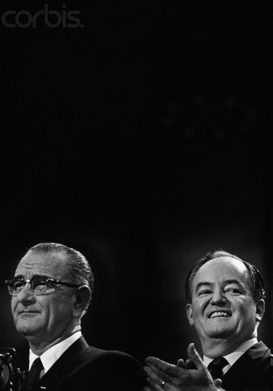
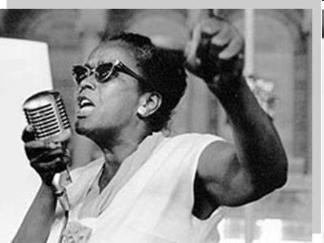
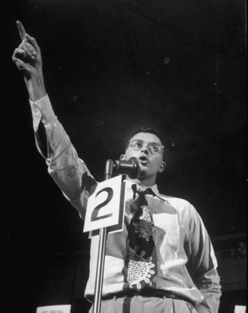
The 1964 Democratic Convention Compromise
Only two members of the MFDP allowed to sit in 1964 DNC delegation
But DNC changes rules to prevent discrimination in future conventions
Al Lowenstein; Ella Baker; Lyndon Johnson; Hubert Humphrey

Slide 23
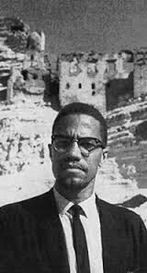
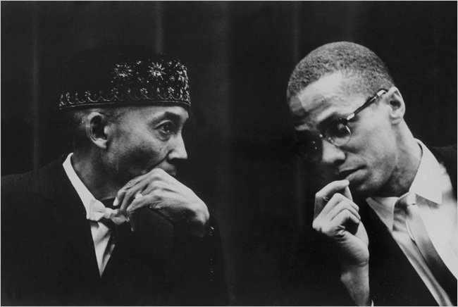
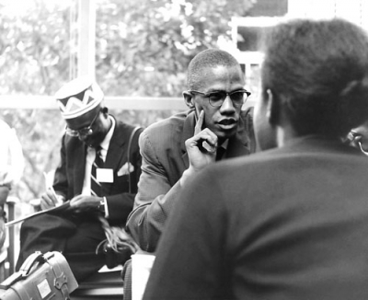
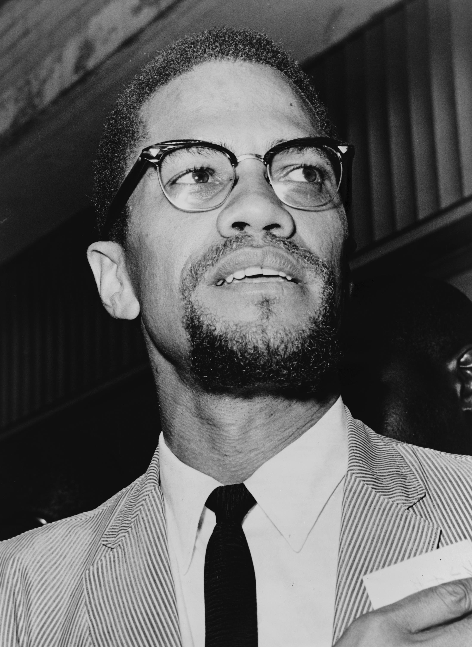
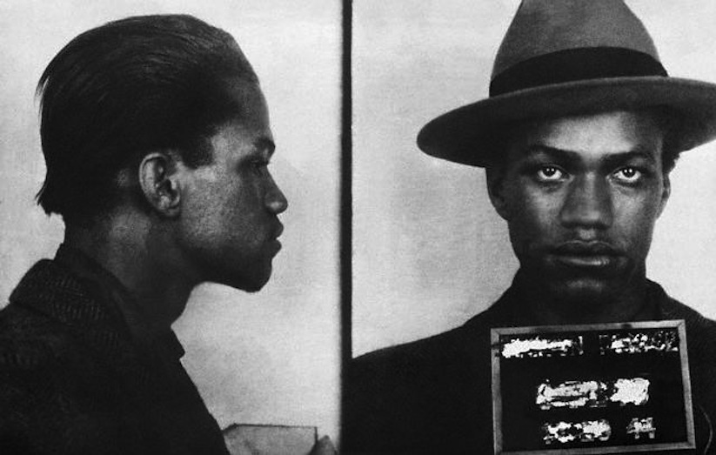
Malcolm X

Slide 24
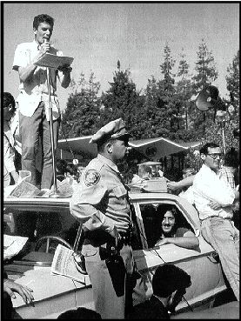
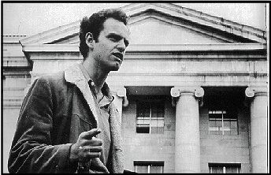
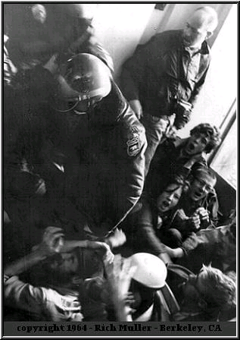
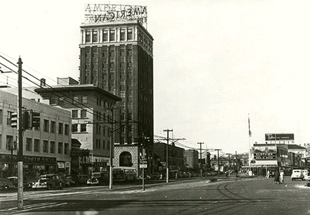
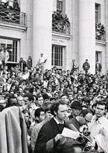
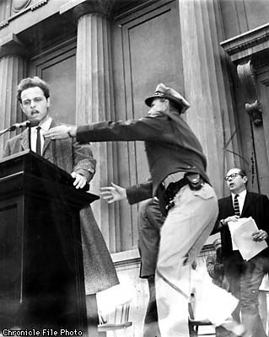
Mario Savio of the Berkeley Free Speech movement

Slide 26
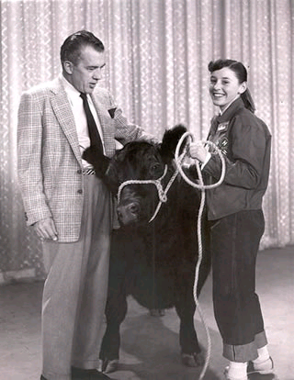
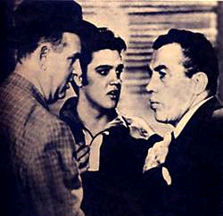
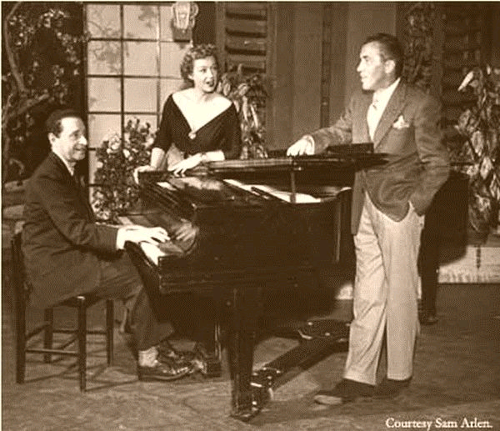
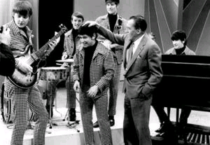
The Ed Sullivan Show, 1948-1971
3 networks:
ABC
CBS
NBC

Slide 27
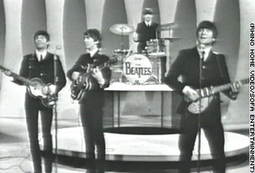
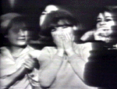
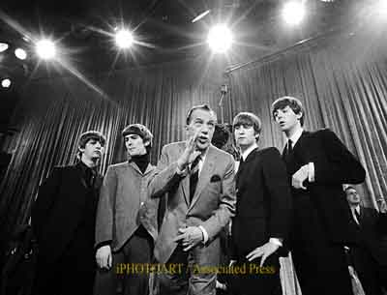
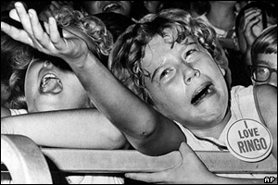
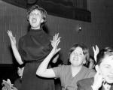
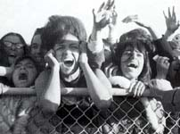

Slide 28
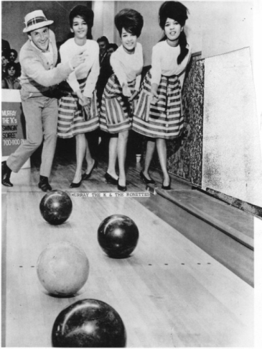
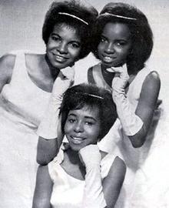
He went away and you hung around And bothered me, every night And when I wouldn't go out with you You said things that weren't very nice
My boyfriend's back and you're gonna be in trouble (Hey-la-day-la my boyfriend's back) You see him now, you better cut out on the double . . .
You been spreading lies that I was untrue (Hey-la-day-la my boyfriend's back) So look out now cause he's comin' after you

Slide 29
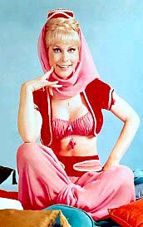
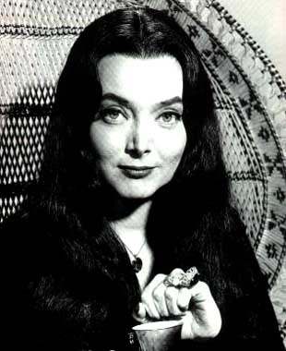
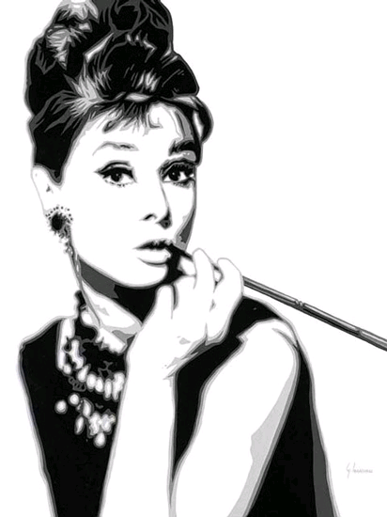
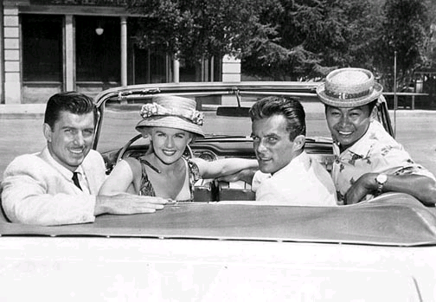

Slide 30
Woody Guthrie
Bob Dylan

Slide 31
Before World War II no public university had more than 15,000 students; by 1970 eight had 30,000 students

Slide 32
Clockwise: the Liberty League, a National Association of Manufacturers poster, 1936 Republican Presidential contender Alf Landon

Slide 35
Arizona Senator Barry Goldwater

Slide 36
Little Rock High School Crisis Arkansas, 1957
Arkansas Governor Orval Faubus refuses to allow integration at Little Rock, High
Eisenhower sends in Federal troops to enforce integration

Slide 37
William F. Buckley

Slide 39
Architects of the Vietnam War
Walter Rostow
Ford’s Robert McNamara
Ngo Dinh Diem
Henry Cabot Lodge, II

Slide 40
Article 1, Section 8, paragraph 11 of the United States Constitution
“Congress shall have the Power . . . To declare War, grant Letters of Marque and Reprisal, and make Rules concerning Captures on Land and Water.”
The Gulf of Tonkin
U.S.S. Maddox

Slide 41
Gulf of Tonkin Resolution August 7, 1964
Section 2. . . . the United States is, therefore, prepared, as the President determines, to take all necessary steps, including the use of armed force, to assist any member or protocol state of the Southeast Asia Collective Defense Treaty requesting assistance in defense of its freedom.

Slide 42
Lyndon Johnson (D) vs. Barry Goldwater (R), 1964
Johnson: 61%
Goldwater: 38.4%
Ronald Reagan (R) vs. Pat Brown (D), 1966
Reagan, 57%
Brown, 42.3%

Slide 43
The Voting Rights Act of 1965
Abolished literacy tests
Placed federal monitors in states with a history of discrimination
24th Amendment (1964) abolishes poll taxes
By 1967, half of African-Americans in the south had registered to vote
Police attack protestors in Selma to Montgomery march, 1965

