Slide 1
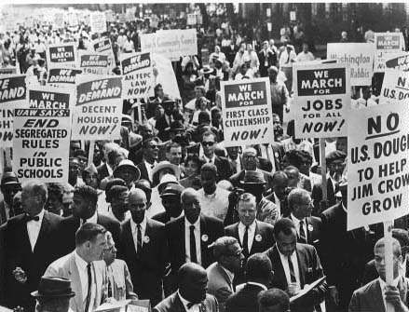
March on Washington, 1963

Slide 2
34 people killed in the riot
1,000 injured
107,000 participants
16,000 police and National Guardsmen intervene

Slide 3
Study done of police behavior between 1962 and 1965 in Watts:
65 inquests involving homicide by officers
Of 27 people shot in the back by police:
25 were unarmed,
23 were suspected of nonviolent crimes,
4 committed no crime at all at the time of the shoot,
All but one inquest ended up as a justifiable homicide.

Slide 4
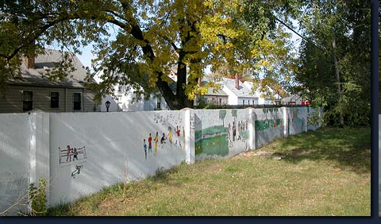
The racialized flight to the suburbs

Slide 5
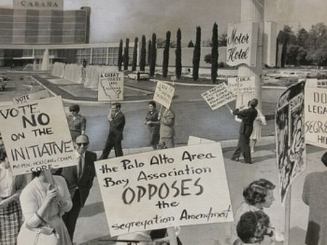

Slide 6
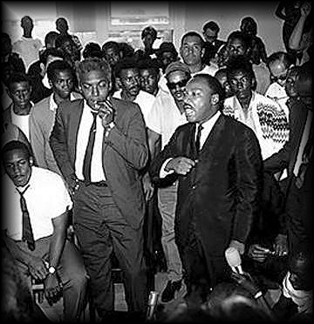
“The looting in Watts was a form of social protest very common through the ages as a dramatic and destructive gesture of the poor towards symbols of their needs.”
Martin Luther King Jr. and Bayard Rustin holding a press conference at Watts

Slide 7
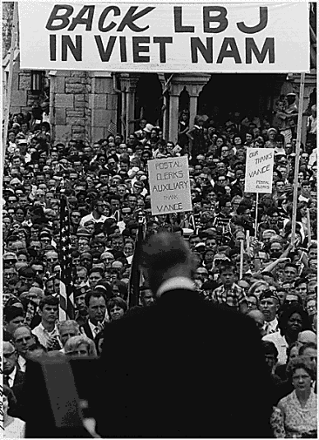
“Tonight, Americans and Asians are dying for a world where each people may choose its own path to change. This is the principle for which our ancestors fought in the valleys of Pennsylvania. It is the principle for which our sons fight in Vietnam.” ―Lyndon Johnson, May 1965

Slide 8
the Vietnam era
1965: 375,000 men and women in Vietnam
1968: U.S. involvement peaks at 543,000
only 11 percent of the country opposed the war in 1965

Slide 9
Vietnam war statistics
9 million men and women served in active duty during the Vietnam war era
over 7,000 women served in Vietnam
58,000 U.S. military personnel died, 47,000 of those in combat
Another 75,000 “severely disabled”
2,338 Missing in Action
766 Prisoners of War

Slide 10
Total Vietnamese killed in their post-World War II war for independence:
3,800,000 Vietnamese killed
One out of ten Vietnamese
This includes all wars with France, Cambodia, the United States, China and Japan . . .
and all political murders committed by Ho Chi Minh, Diem, and other political leaders
Vietnamese killed in the U.S./Vietnam War: 1,719,000
Source: R.J. Rummel, “Statistics of Vietnamese Democide.”

Slide 11
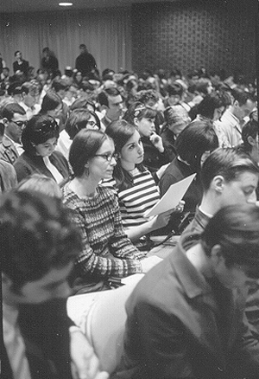
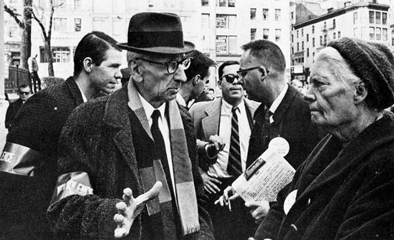
Early resistance to the Vietnam war
1965 teach in on the war at New York University; A.J. Muste and Dorothy Day at an anti-war rally

Slide 12
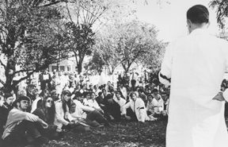
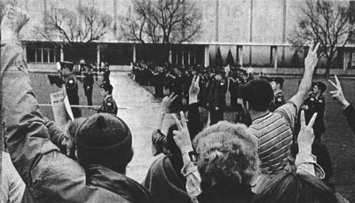
liberal vs. radical anti-war movement
Vietnam teach in at UCLA and Oakland Army base protest in 1965

Slide 13
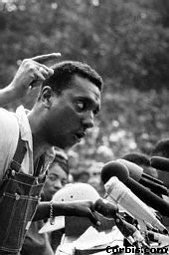
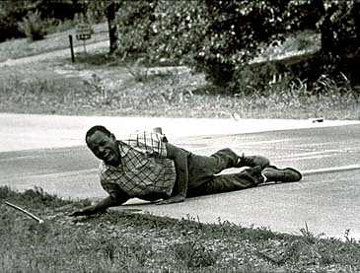
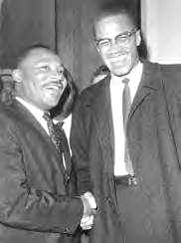
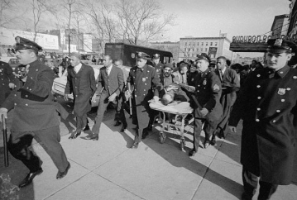
James Meredith shot, 1966
Stokely Carmichael, “Black Power”
Malcolm X, assassinated, 1965

Slide 14
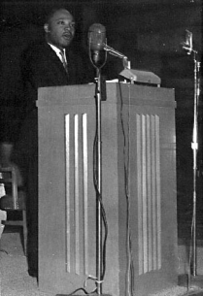
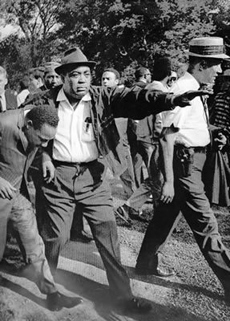
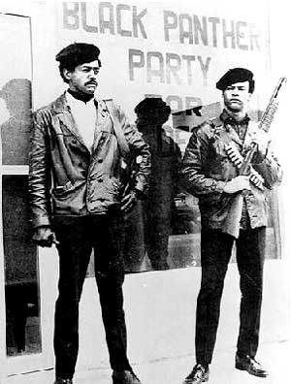
“As I have walked among the desperate, rejected and angry young men, I have told them that Molotov cocktails and rifles would not solve their problems . . . But they asked, what about Vietnam?”

Slide 15
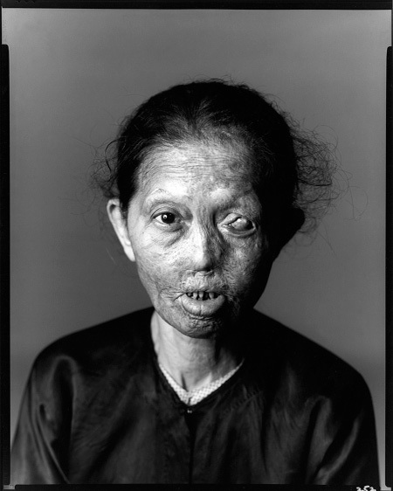
Napalm
gasoline, napthenic acid and palm oil
burns the flesh off of its victims
sucks oxygen from the area and suffocates people

Slide 16
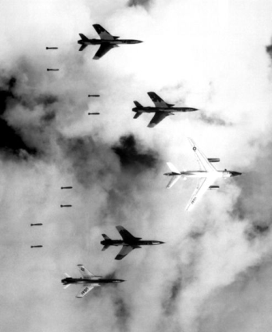
Operation Rolling Thunder
Bombardment campaign against North Vietnam from 1965 through 1968
Objective: Push North Vietnam to settle with the United States
Principal target of Rolling Thunder the “Ho Chi Minh” trail

Slide 17
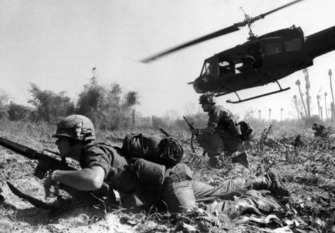
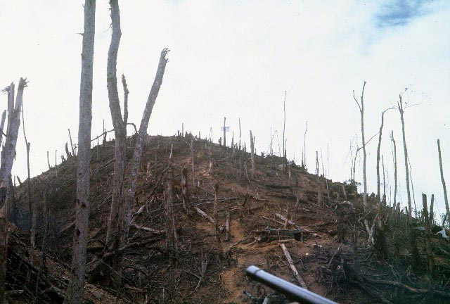
Battle of Ia Drang Valley, 1965
A stalemate despite the introduction of seven Army divisions, two Marine divisions, and five brigades
Hill 875

Slide 18
1967: support for the war begins to wane
71 percent of U.S. public support the war
August it drops to 61 percent
October it slips to 58 percent

Slide 19
Project Head Start, 1965
Food, health care, and day care for poor pre-school children

Slide 20
The Medicare Act, 1965
Medical Insurance for people aged 65 and over

Slide 21
Medicaid, 1965
Health insurance for low income families

Slide 22
National Endowment for Humanities and National Endowment for the Arts, 1965
Funding for artists, scholars, writers, musicians and performers
Usual annual appropriations between 130 to 180 million
Alabama School of Fine Arts

Slide 23
The Immigration and Nationality Services Act, 1965
Abolished national origins quotas
Ended restrictions strategically targeted at Asian immigrants

Slide 24
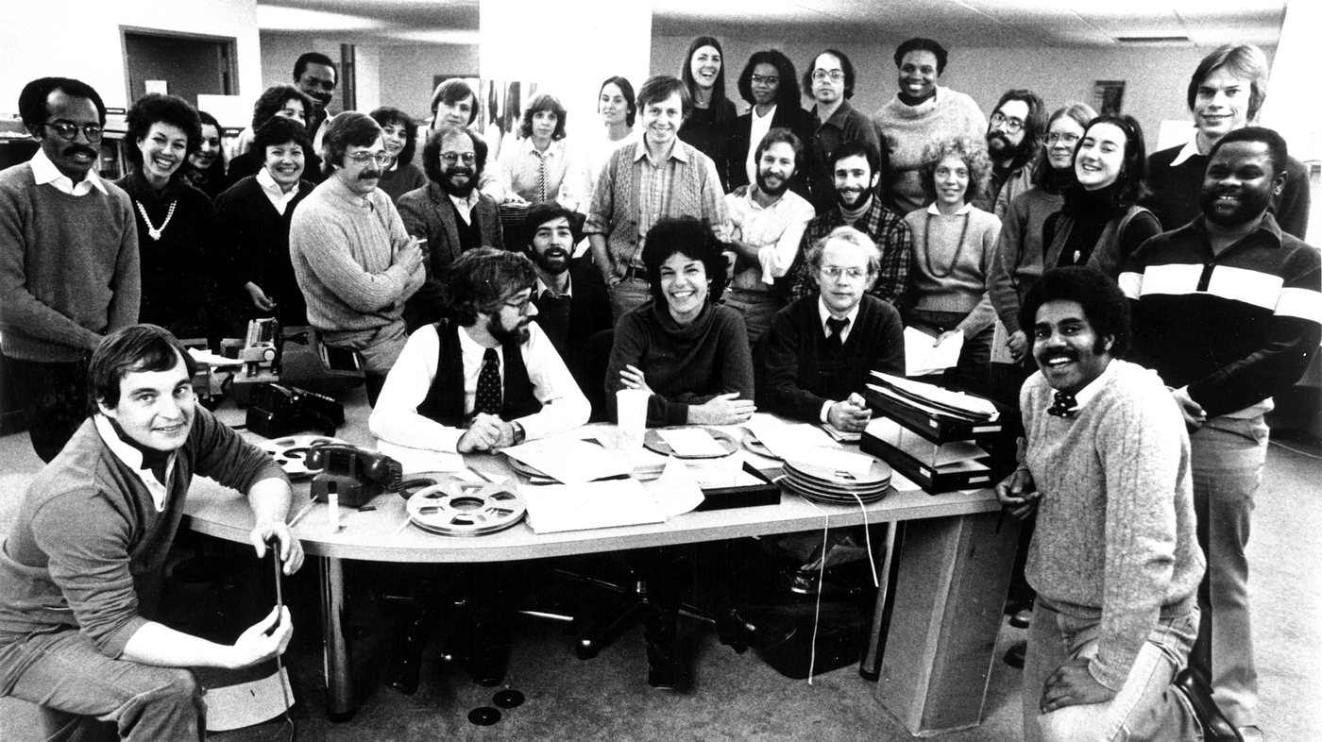
Public Broadcasting Act of 1967

Slide 25
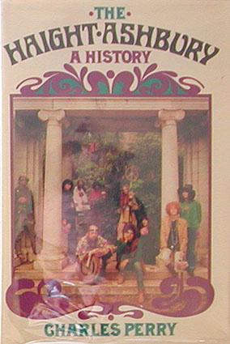
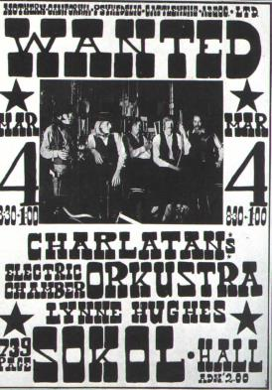
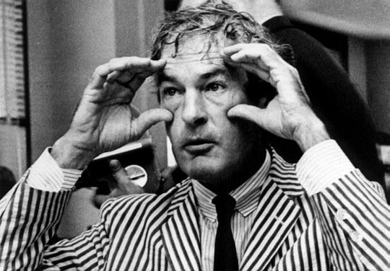
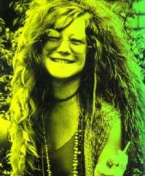
Dr. Timothy Leary

Slide 26
Hippy culture
Emphasis on communalism, sexual freedom, spontaneity
Diggers free clothing store (“If someone asks to see the manager, tell them they’re the manager.”)

Slide 27
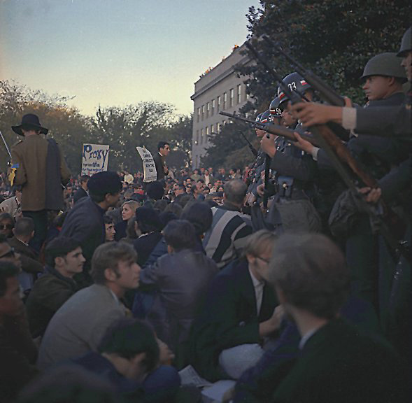

Slide 28
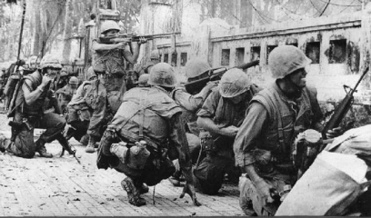
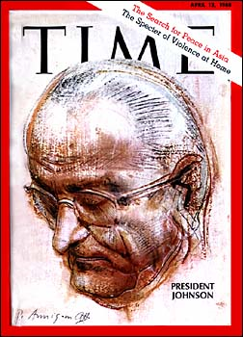
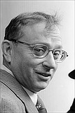
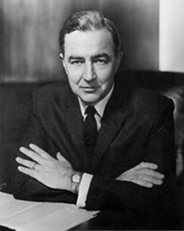
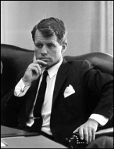
U.S. troops defending against the Tet Offensive
Allard Lowenstein
Eugene McCarthy

Slide 29
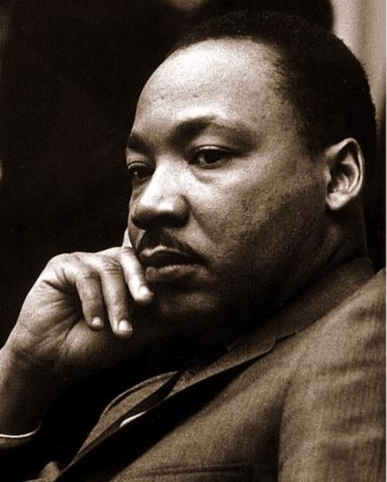
The Fair Housing Act of 1968
Federal law prohibits discrimination because of:
Race or color
National origin
Religion
Sex (gender)
Familial status (including children under the age of 18 living with parents or legal custodians, pregant women)
Disability

Slide 30
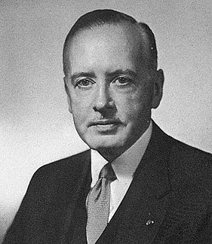
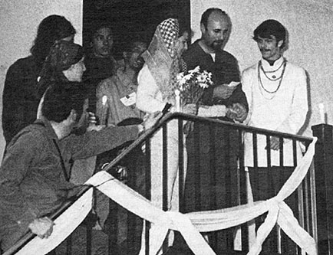
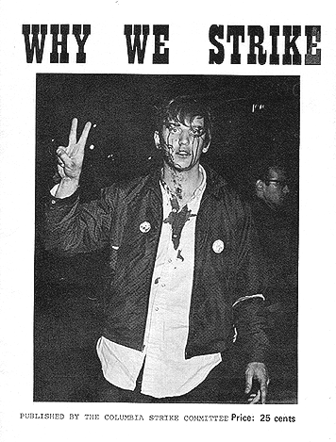
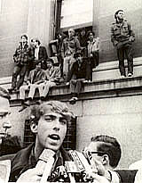
Columbia Strike, 1968

Slide 31
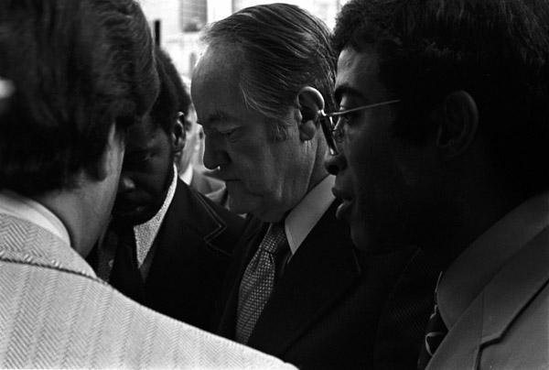
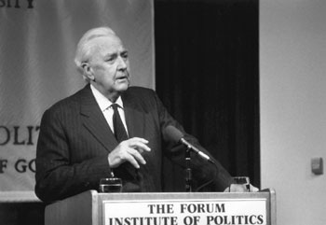
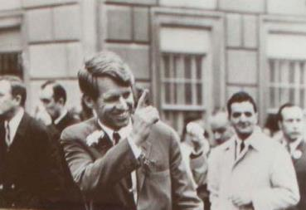
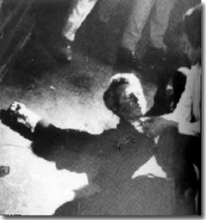
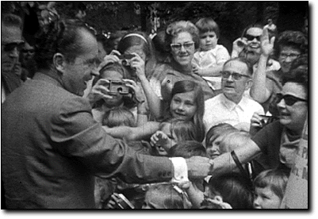
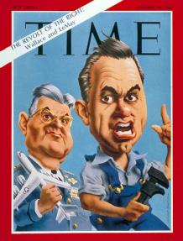

Slide 32
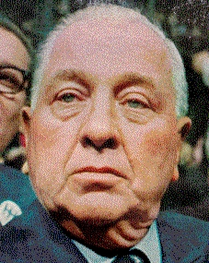
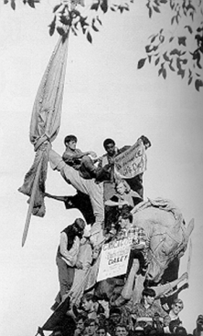
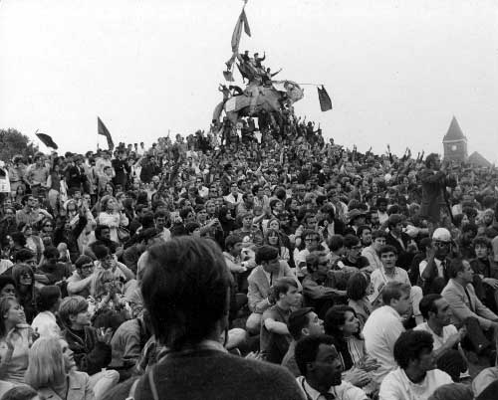
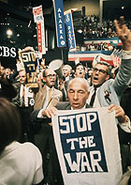
Democratic National Convention, Chicago, 1968

Slide 33
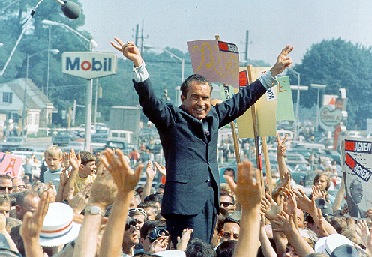
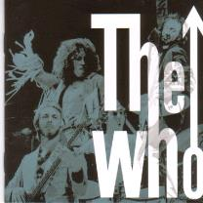
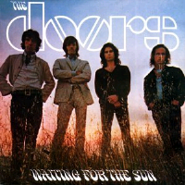
The Presidential Election of 1968
Richard Nixon, 43.42% (301 electoral votes)
Hubert Humphrey, 42.72% (191)
George Wallace, 8.55% (46)
Richard Nixon

Slide 34
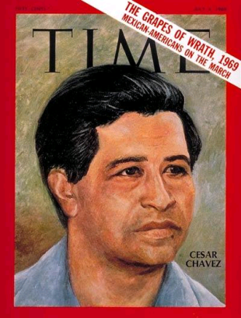

Slide 35
The Sleepy Lagoon defendants declared not guilty, 1944

Slide 36
The Bracero Program, 1942-1964
“El Cortito”—the Devil’s Arm

Slide 37
Fred Ross, Saul Alinsky and “community organizing”
Delores Huerta and Fred Ross of Community Service Organizations

Slide 38
The grape boycott
National boycott of west coast grapes results in significant unionization of San Joaquin valley workers by 1970

Slide 39
Latino Civil Rights groups in the United States
1929: League of United Latin American Citizens (LULAC)
1938: El Congresso de los Pueblos de Habla Espanol
1948: The GI Forum—an association of Mexican American World War II veterans
1949: the National Mexican-American Association

Slide 40
Rodolfo “Corky” Gonzales
Crystal City High School, 1969

Slide 41
Pre-civil war feminists: Susan Anthony, Amelia Bloomer, Elizabeth Stanton, Sojourner Truth, Lucy Stone,

Slide 42
Women’s suffrage map, USA

Slide 44
Women at work and at college

Slide 45
Title VII of the 1964 Civil Rights Act
(a) It shall be an unlawful employment practice for an employer - (1) to fail or refuse to hire or to discharge any individual, or otherwise to discriminate against any individual with respect to his compensation, terms, conditions, or privileges of employment, because of such individual’s race, color, religion, sex [gender], or national origin . . .”

Slide 46
Discrimination against women in America
Newspaper jobs divided into male and female
Government manuals used “he” and “she” to describe managers and secretaries
Women could not establish businesses without a male consigner
Quotas for women in professional schools
Higher university admission standards for women
Laws permitting husband to beat their wives
Employers could fire women for weighing too much

Slide 47
1969: Miss America Pageant Protest

Slide 48
Feminist victories in the 1970s
1970: Schultz v. Wheaton. U.S. appeals court says employers can’t change job title of women workers to pay them less than men
1972: Congress passes Educational Amendments (Title IX) to the Civil Rights Act to enforce sex equity in education
1973: Supreme Court rules that sex categorizing in employment advertisements is unconstitutional
1974: The Equal Credit Opportunity Act prohibits discrimination in consumer credit practices on the basis of sex, race, marital status, religion, national origin, age, or receipt of public assistance.

Slide 49
Feminist victories in the 1970s
1974: Corning Glass Works v. Brennan, the U.S. Supreme Court rules that employers cannot justify paying women lower wages because that is what they traditionally received under the "going market rate."
1976: West Point, Annapolis, and the Air Force Academy open admissions to women
1976: Nebraska first state to make it illegal for a husband to rape his wife
1978: Pregnancy discrimination act. You can’t get fired or demoted or not promoted for being pregnant

Slide 50
Katherine Switzer at the 1967 Boston Marathon

Slide 51
Reproductive law timeline
Up until 1820s reproductive law permitted abortion until “quickening”
1821: banned certain kinds of abortions that used dangerous herbs and roots
1850s: American Medical Association campaigns against midwives and abortion
1873: Comstock Act bans information about abortion of contraception through the mails
1910: Almost all states have anti-abortion laws
Moral crusader Anthony Comstock

Slide 52
1965: AMA begins to change stance on abortion after German measles epidemic
1967: Ronald Reagan signs Therapeutic Abortion act
1969: New York doctors openly defy states anti-abortion law
1970: 17 states liberalize abortion laws
1971: a Federal appeals court declares Comstock law unconstitutional
1973: Roe Versus Wade declares that abortion is a private decision in the first trimester of pregnancy
Sherri Finkbine and her three kids

Slide 53
Roe v. Wade, 1972
Texas law banning abortion declared unconstitutional by the U.S. Supreme Court
Supremes argued that the law violated Norma McCorvey’s right to privacy and due process of law, implied and protected by the 5th and 14th amendment’s “due process” clause:

Slide 55
George McGovern, 1972; Ralph Nader; Lewis Powell

Slide 59
Watergate hearings, 1974
George McGovern, 1972
Le Duc Tho and Henry Kissinger, 1973

