Slide 1
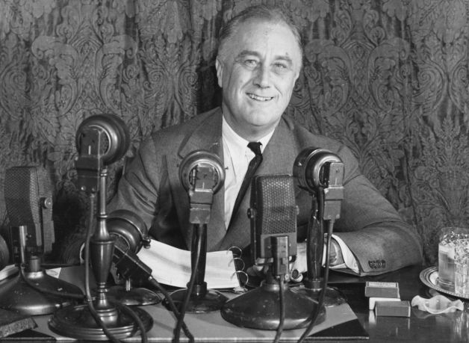
Welcome to the year
1945 . . .

Slide 2
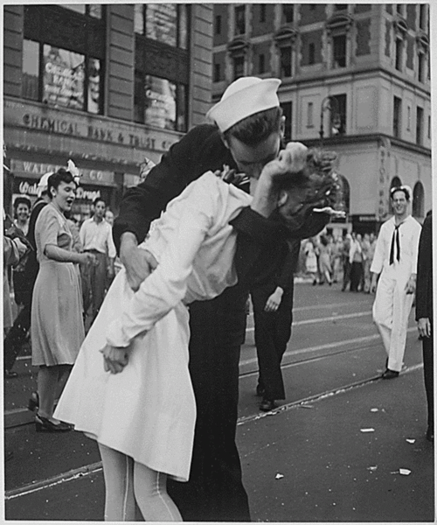
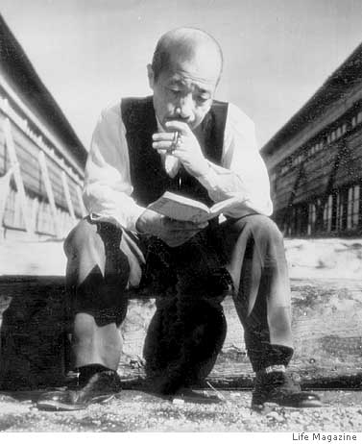
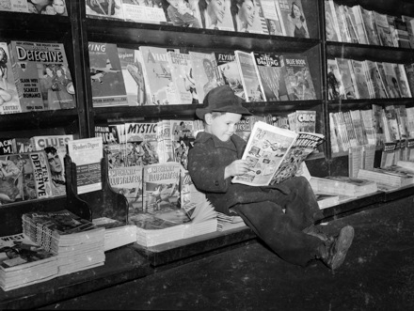
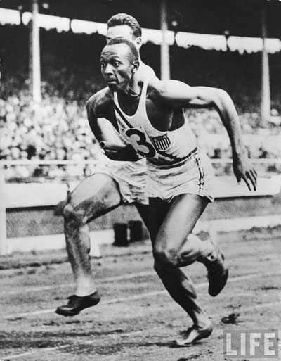
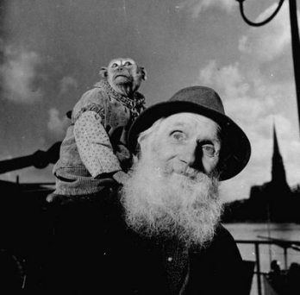
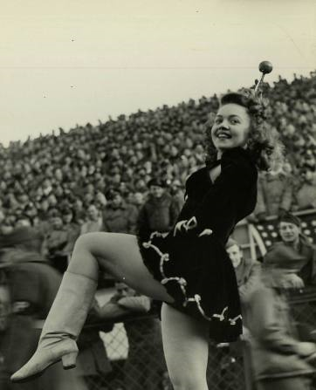
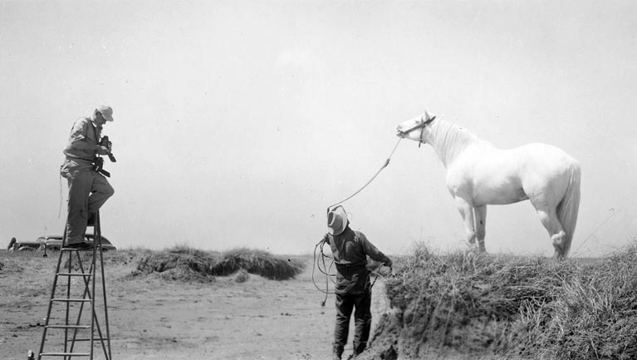
1945

Slide 3
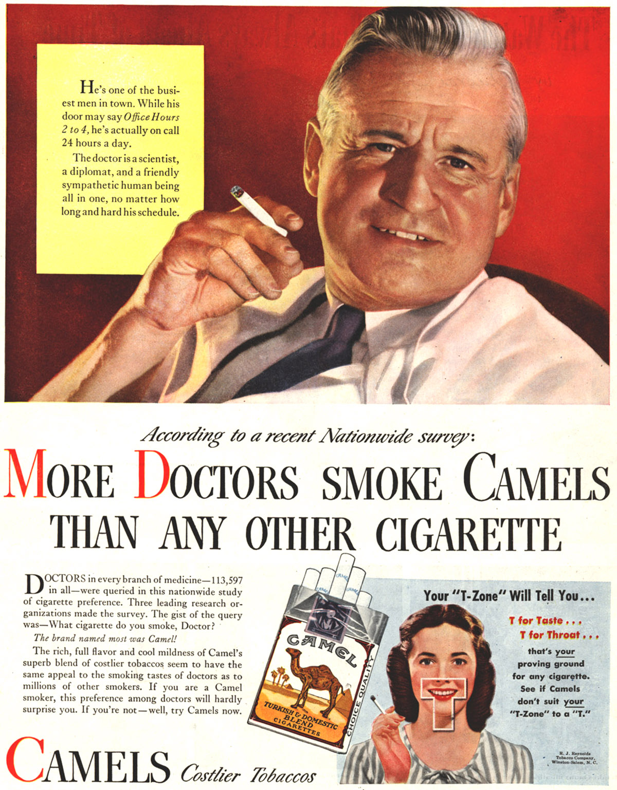
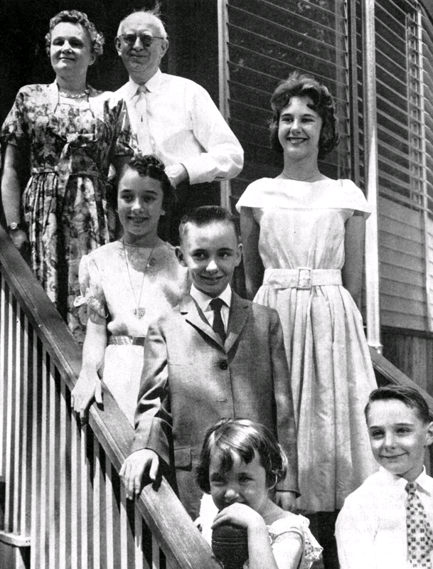
1955

Slide 4
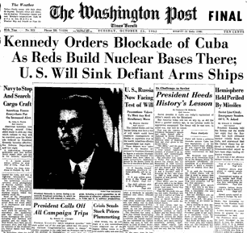
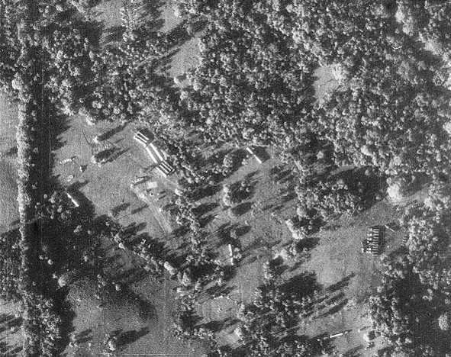
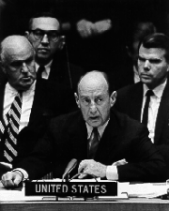
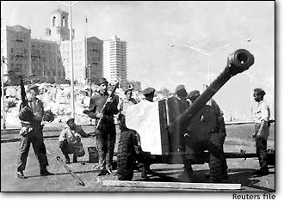

Slide 5
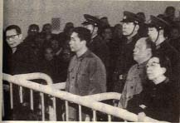
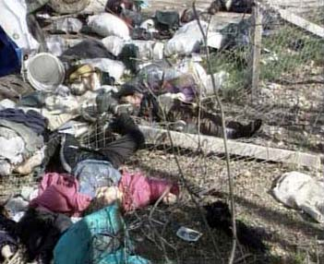
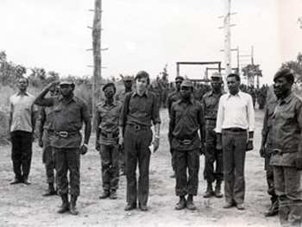
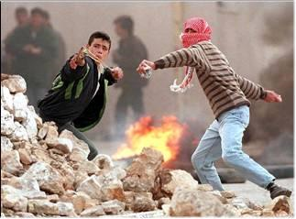

Slide 6
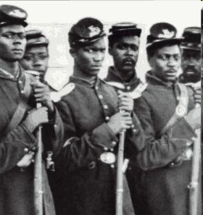
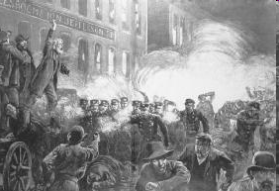
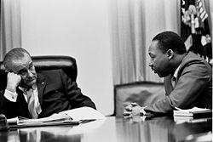
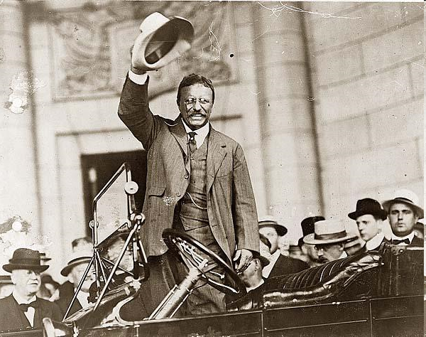
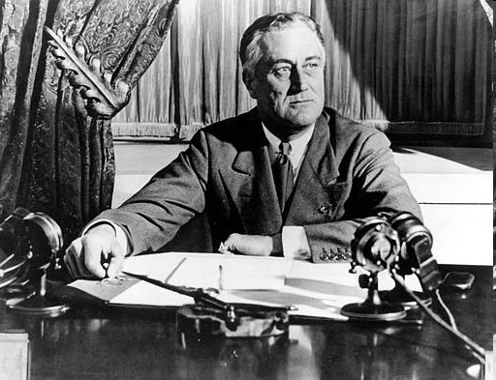
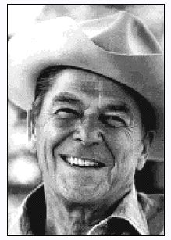

Slide 7
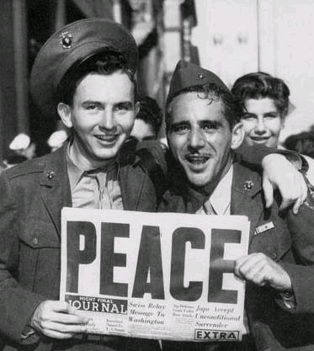
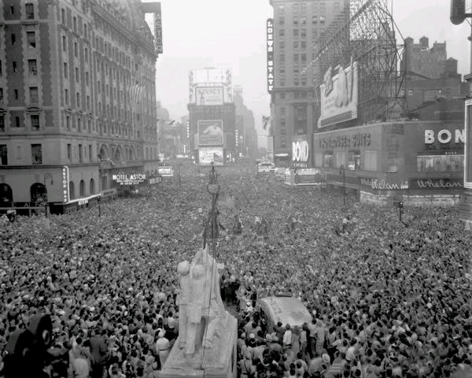
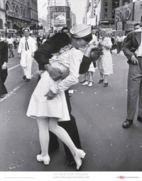

Slide 8
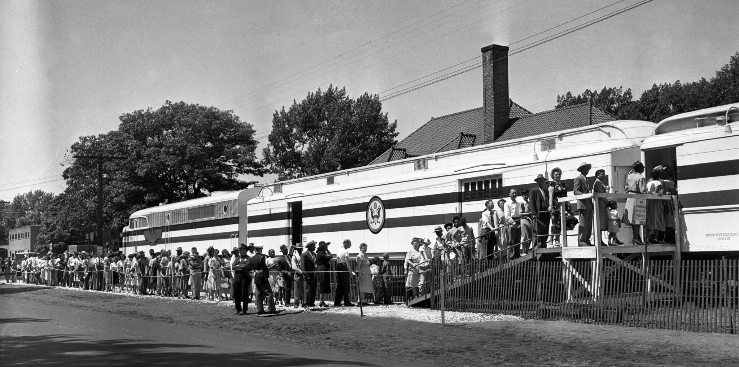
The Freedom Train, Muskegon, MI, 1948

Slide 9
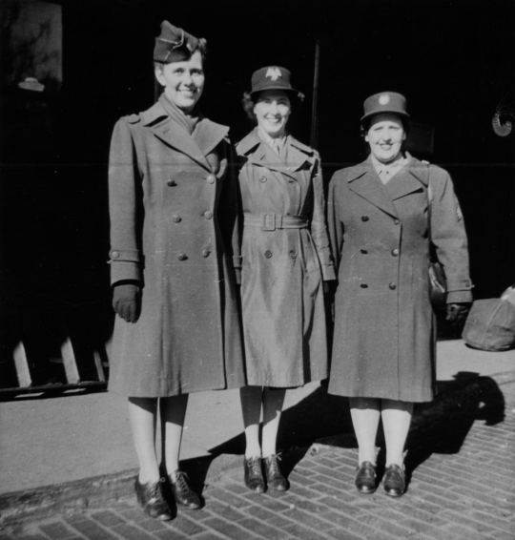
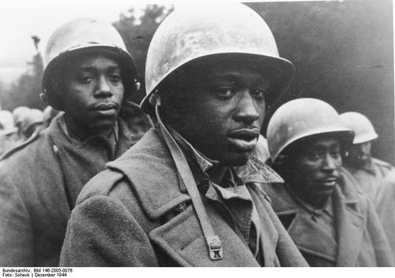
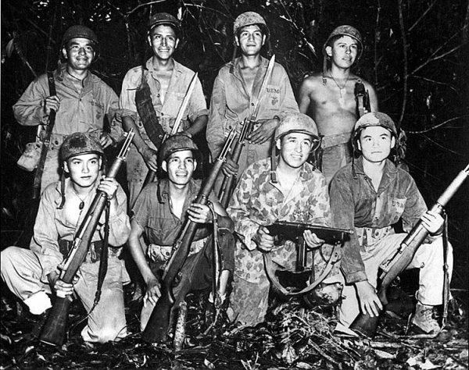
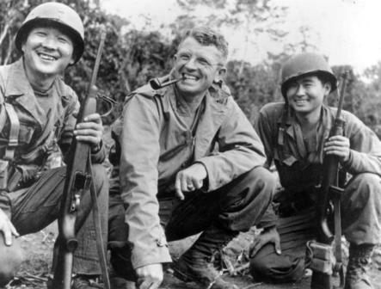

Slide 11
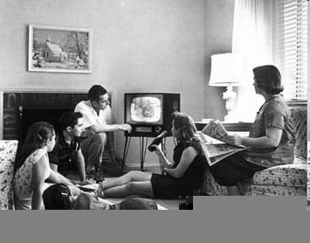
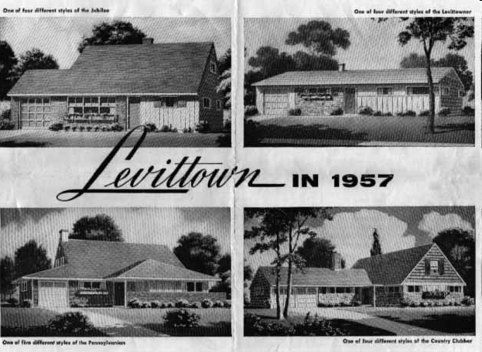
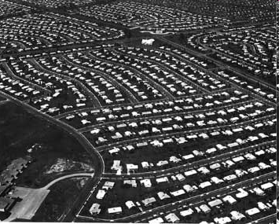
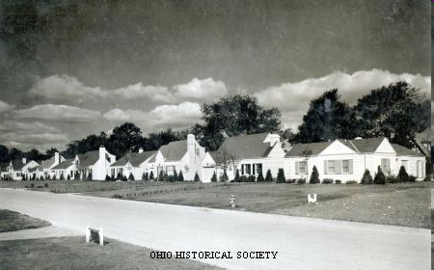
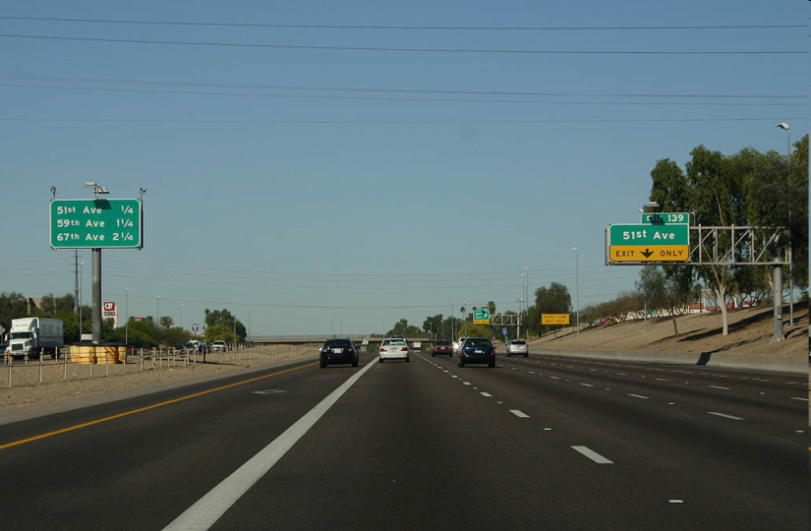

Slide 12
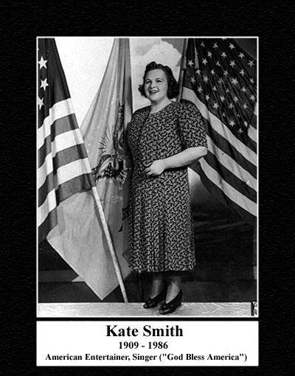

Slide 13
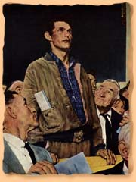
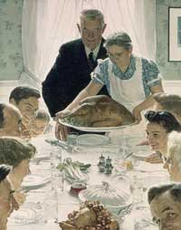
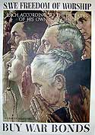
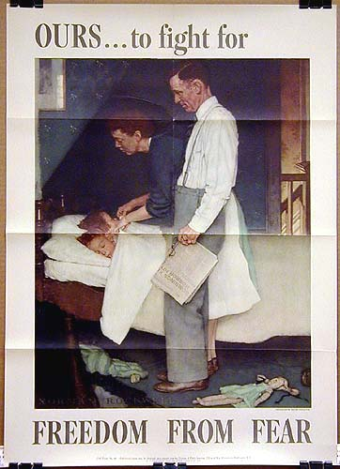
FDR’s Four Freedoms speech, via Norman Rockwell, January 6, 1941

Slide 14
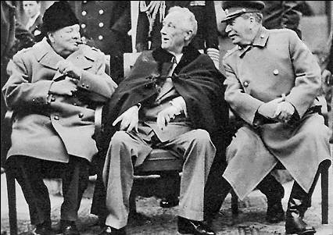
The Yalta Conference, 1945

Slide 15
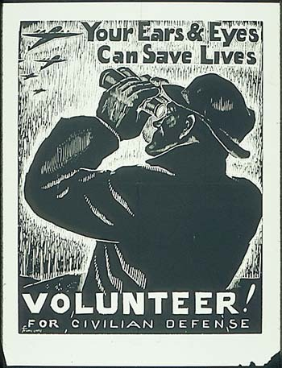

Slide 16
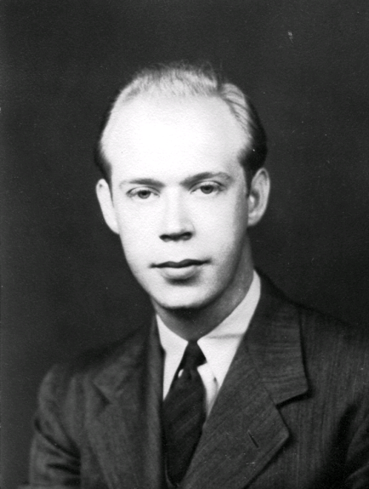
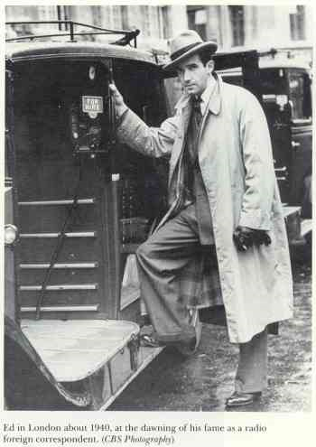
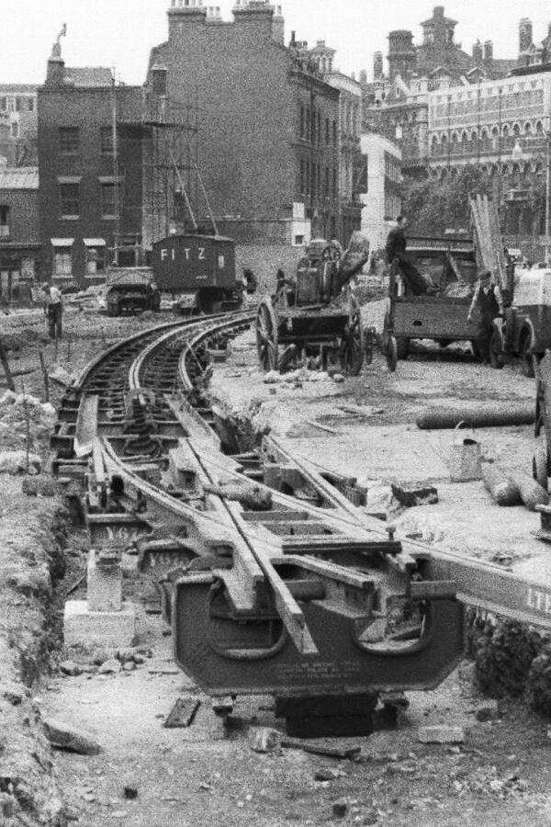
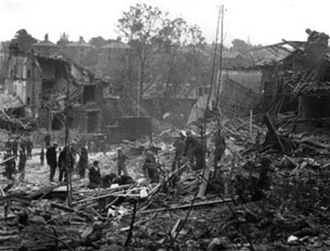
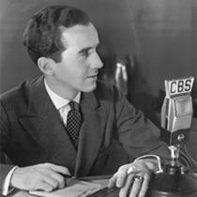

Slide 17
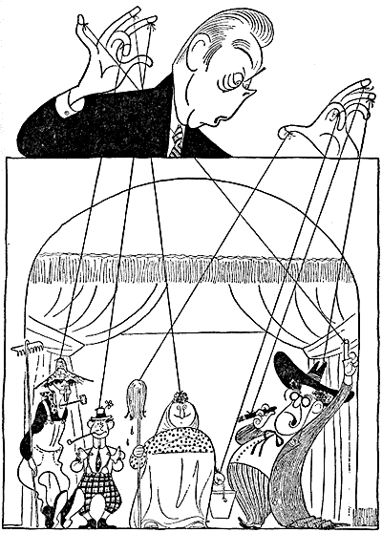

Slide 19
John L. Lewis of the United Mine Workers
Fred Allen and Portland Hoffa

Slide 24
Dr. Hector Garcia; 442nd regiment; African American GIs as US poised to occupy Germany

Slide 25
Bay Area defense workers during World War II

Slide 26
Electronic Numerical Integrator and Calculator (ENIAC)

Slide 27
1939: Einstein and Szilard warn Roosevelt about Nazi research on Atomic weapons

Slide 28
August 6 and 9, 1945: Atomic weapons used on Hiroshima and Nagasaki

Slide 29
Wilson liberalism versus Russian Marxism Leninism

Slide 30
The Polish Corridor to Russia
15th century Teutonic invasion
Napoleon’s 1812 invasion
The Kaiser’s 1914 invasion
The Nazi invasion of 1941

Slide 31
Joseph Stalin, dictator of the Soviet Union

Slide 32
Harry Truman of Missouri
Truman and political boss, Jim Pendergast (left); being sworn in, 1946

Slide 33
“We must not let our Russian policy be guided or influenced by those inside or outside the United States who want war with Russia.” – Henry Wallace
“An Iron Curtain has descended across the continent.” –Winston Churchill

Slide 34
Army Information Map, “Newsmap for the Armed Forces,” 1946; right: Tehran in 1946

Slide 35
Marshall Islands Bikini Atoll tests of 1940s; 23 nuclear devices were exploded in the area.

Slide 36
The Truman Doctrine (1947)
“The Free Peoples of the World look to use for support in maintaining their freedoms.”

Slide 37
George Kennan’s “containment” thesis, 1946
The Soviet Union must be “contained by the adroit and vigilant application of counterforce at a series of constantly shifting geographical points . . . ”

Slide 38
Walter Lippmann: “The Cold War” (1947)
Containment “concedes to the Kremlin the strategic initiative as to when, where and under what circumstances the issue will be joined.”

Slide 39
The Marshall Plan, 1947
“ . . . the revival of a working economy in the world so as to permit the emergence of political and social conditions in which free institutions can exist.”

Slide 40
1944: Breton-Woods conference

Slide 41
The Berlin Airlift, 1948-49

Slide 42
Communist revolution in China, 1949
Mao Zedong
Chiang Kai Shek

Slide 43
NSC-68 (National Security Council document # 68), 1950
Conflict between the superpowers “endemic” . . . like a disease, inherent

Slide 44
Kim Il Sung of North Korea
Syngman Rhee of South Korea

Slide 45
Korean War, 1950-1953
The Yalu River from aerial View
U.S. retreat from the Yalu River, 1950

