Slide 1
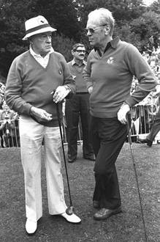
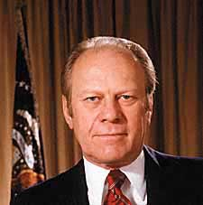
Gerald Ford

Slide 2
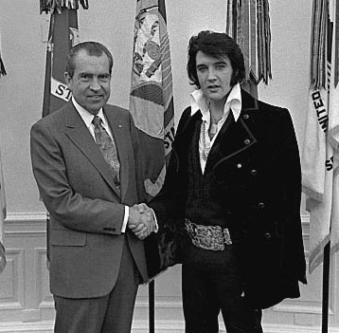
Nixon’s domestic record
Increased spending on social security
Increased spending on Medicare and Medicaid
Signed Clean Air Act in 1970
Created Occupational Safety and Health Administration (OSHA), 1971
Created Environmental Protection Agency in 1972
Supported Affirmative Action
Nixon as cool guy

Slide 3
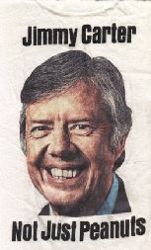
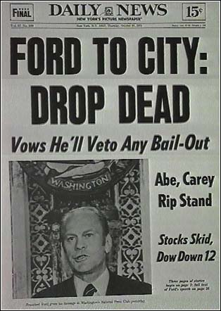
Presidential election of 1976:
Jimmy Carter: 50.8 pct of vote
Gerald Ford: 48.2 pct of vote

Slide 4
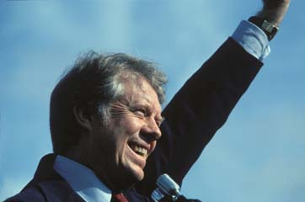
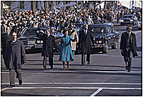

Slide 5
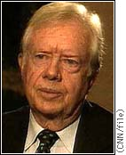
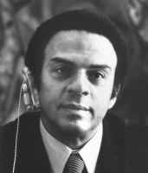
Carter contributions
Department of Education in 1979
Reformed Civil Service
Environmental Superfund
100 million acres of land set aside in Alaska
Appointed women and minorities to office in record numbers . . .
Andrew Young, Carter’s ambassador to United Nations

Slide 6
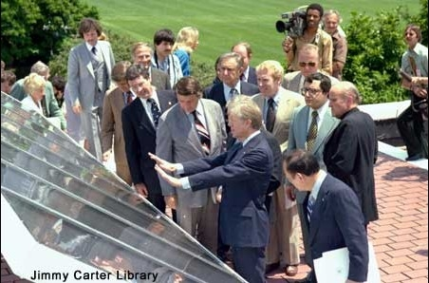
Carter’s energy policy
By 1985:
Reduce annual rate of energy demand by 2 percent
Cut national gasoline use by 10 percent
Cut consumption of imported oil
Rely more on solar energy and insulation

Slide 7
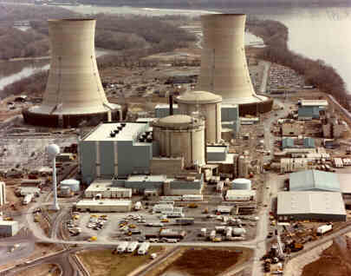
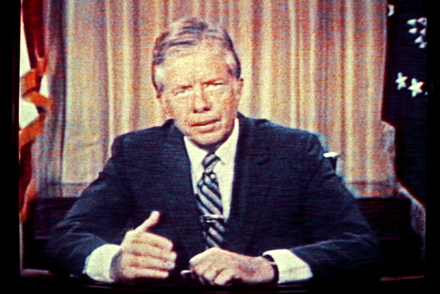
Three mile island, March 1979

Slide 8
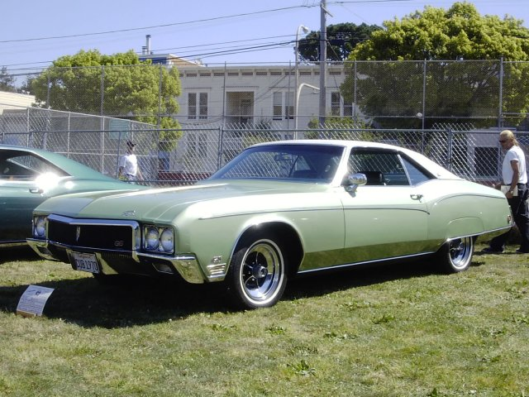
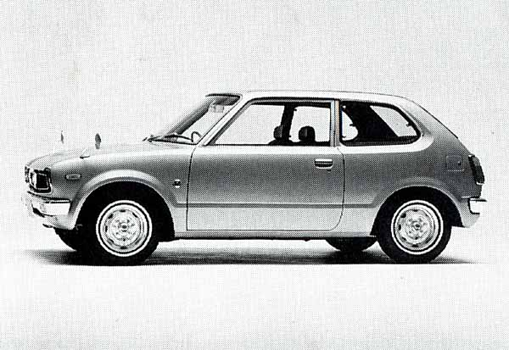
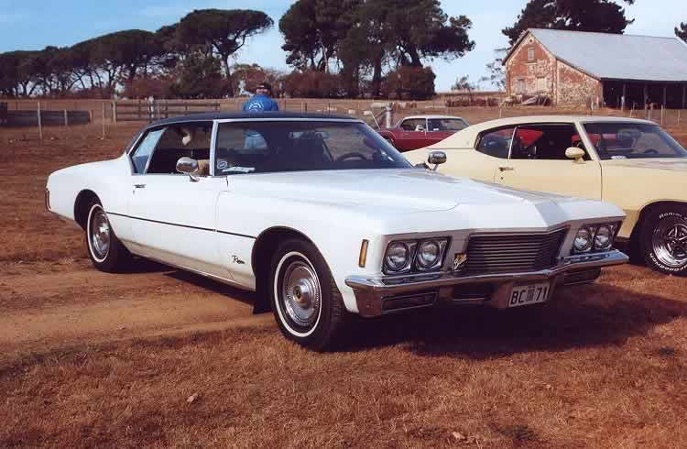

Slide 9
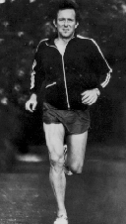
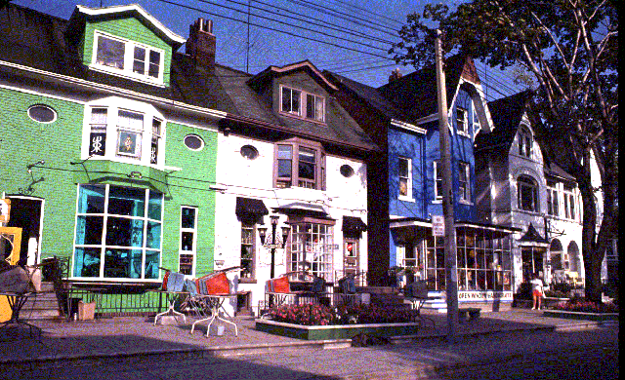


Slide 10
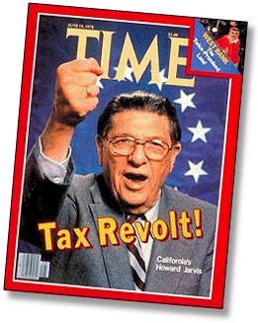
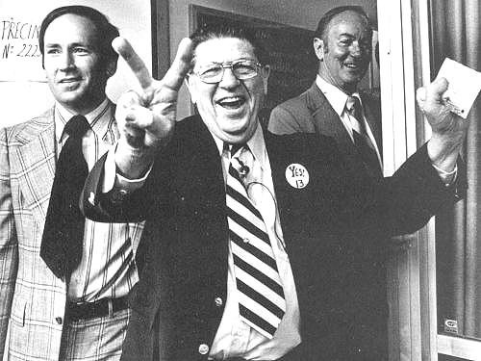
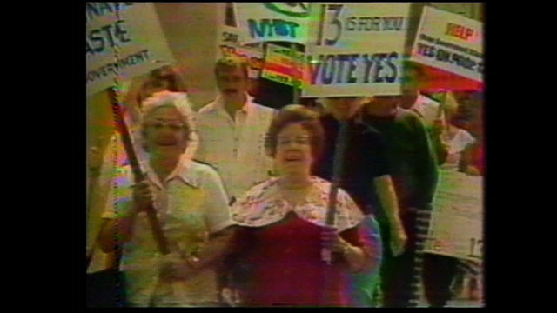
Proposition 13 (1978) cut real estate taxes and dramatically curtailed the state’s taxation powers

Slide 11
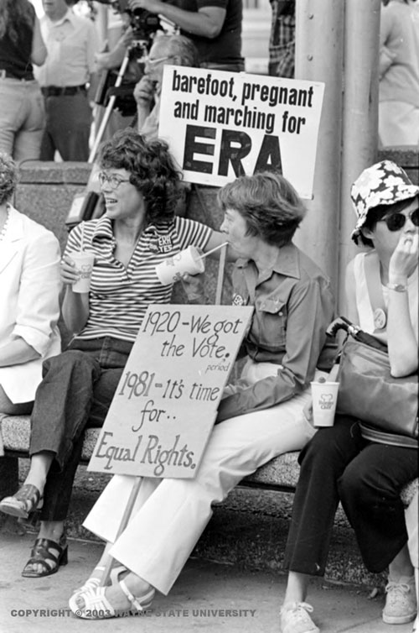
Equal rights amendment, second try:
"Equality of rights under the law shall not be denied or abridged by the United States or by any state on account of sex.”

Slide 12
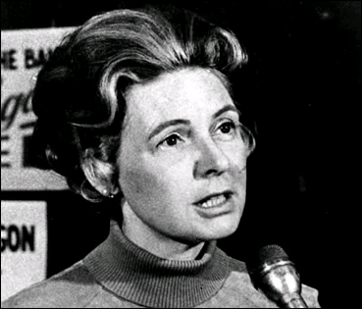
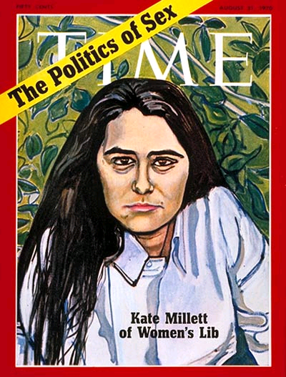
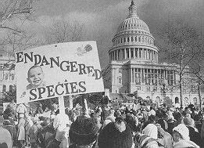
1976: Congress bans Medicare from funding abortions
1978: Military personal health benefits cannot be used for abortion
Phyllis Schlafly

Slide 13
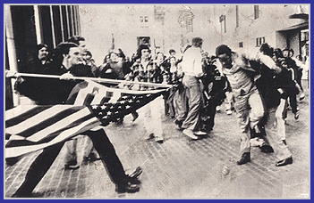
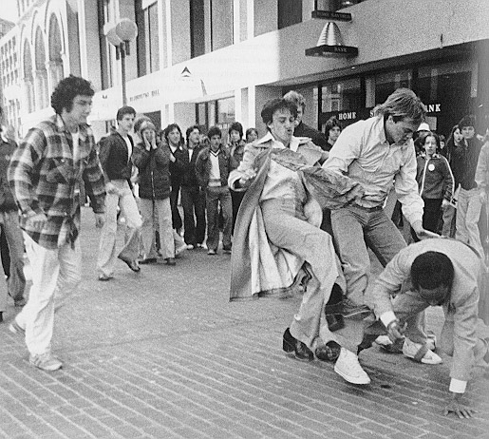
White Bostonians riot against busing in Boston, 1974

Slide 14
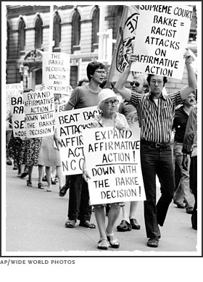
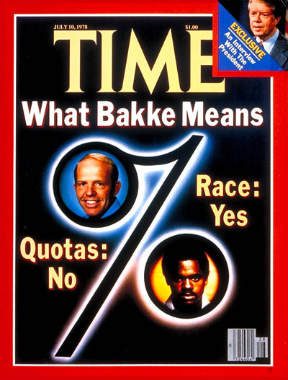
Bakke v. UC Davis, 1978
Supreme Court says that schools can consider race as a factor in admissions, but they cannot establish quotas.

Slide 15
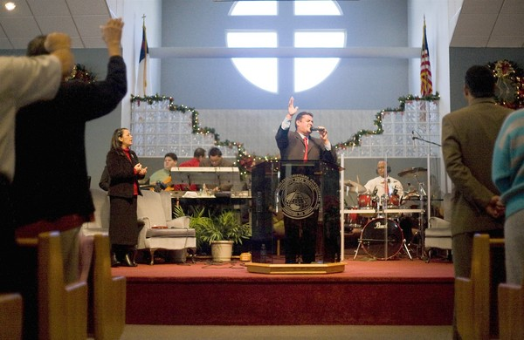
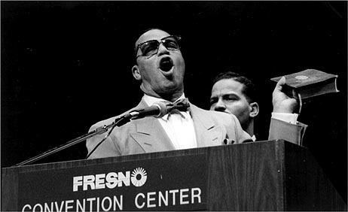
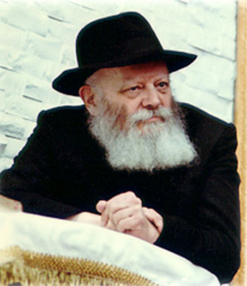
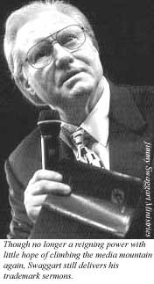
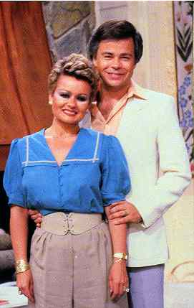
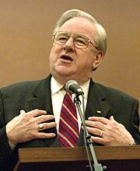
From upper left around to lower left: Louis Farrakhan, Pentecostal church ceremony, Menachem Scheerson, Jerry Falwell, Jim and Tammy Bakker, Jimmy Swaggart

Slide 16
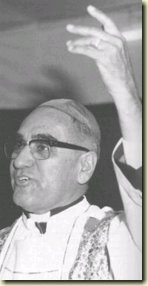
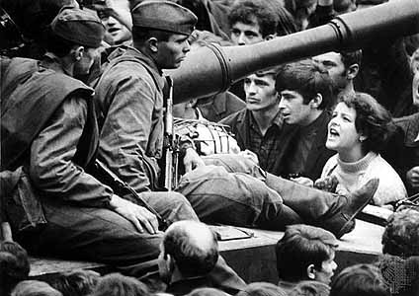
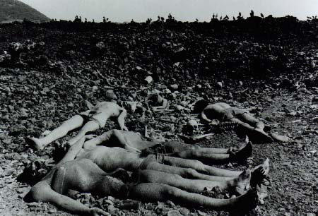
Carter’s “human rights” policy
Students confronting Soviet troops in Czechosloakia; the Death Squad fields of El Playa and El Salvador’s assassinated Archbishop Oscar Romero

Slide 17
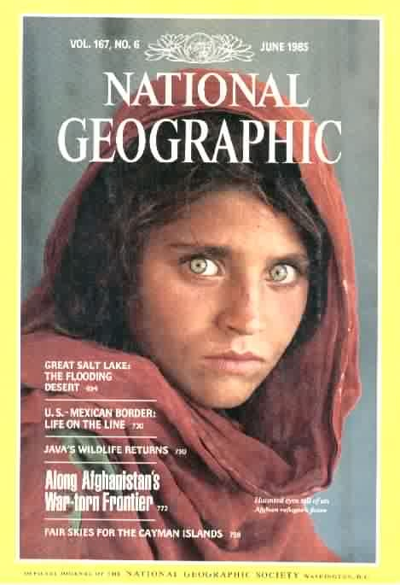
The Carter Doctrine, 1980
“Let our position be absolutely clear: An attempt by any outside force to gain control of the Persian Gulf region will be regarded as an assault on the vital interests of the United States of America, and such an assault will be repelled by any means necessary, including military force. “
Soviet Union invades Afghanistan in 1979

Slide 18
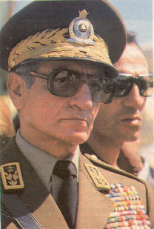
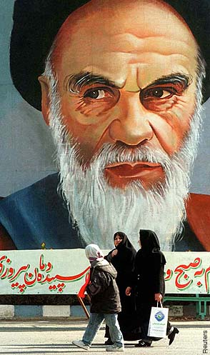
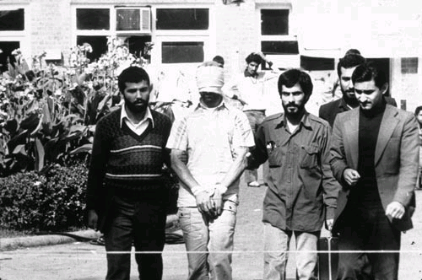
Revolution in Iran, 1979
Left to right: The Shah of Iran, overthrown by Ayatollah Ruhollah Khomeini; a U.S. embassy hostage show by Iranian captors, 1979

Slide 19
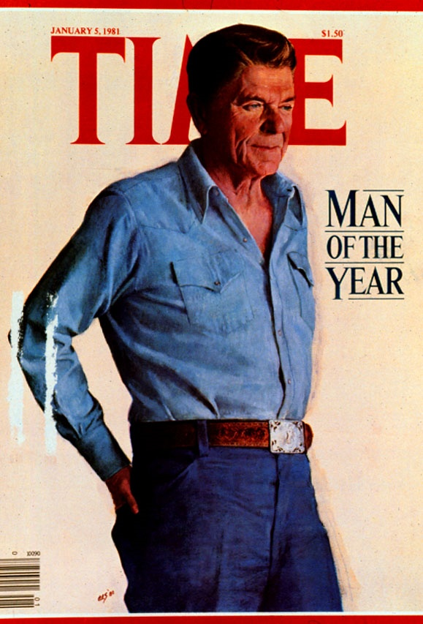
Election of 1980
  Ronald Reagan: %50.7
  Jimmy Carter: %41.0
  John Anderson: %6.6

Slide 20
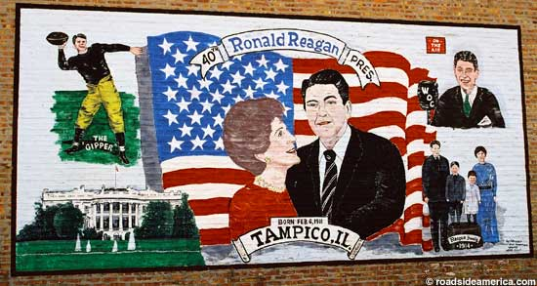
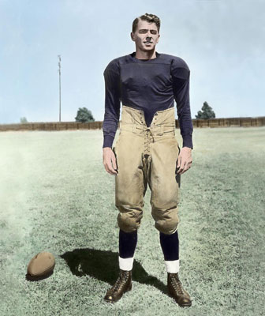

Slide 21
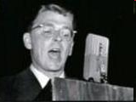
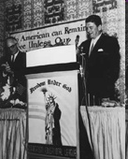
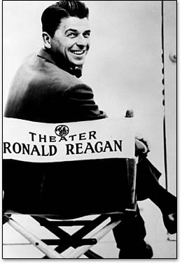
1948: Reagan supports Democrat Harry Truman
1954: Is hired to host General Electric TV Theater
1964: Supports Barry Goldwater for President

Slide 22
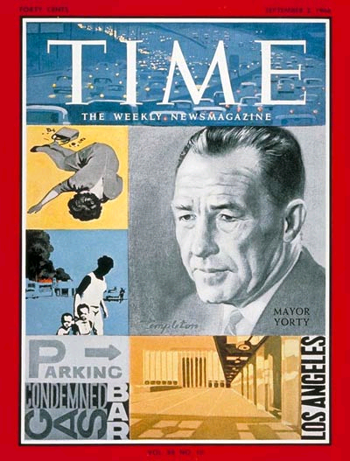
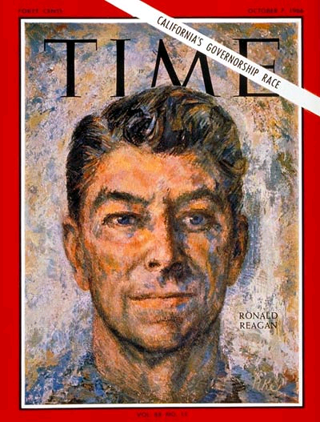
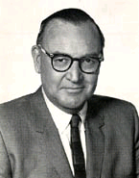

1966: California Gubernatorial election
Democrats: Liberal Pat Brown versus Sam Yorty of Los Angeles; after the primary Yorty voters support Reagan
Reagan easily beats liberal Republican George Christopher of San Francisco for the Republican nomination
In November Reagan beats Brown, 57.6 to 42.3 percent

Slide 23



Slide 24






Slide 25





Slide 26
The Reagan Coalition
Free market ideologues, usually backed by corporate money
  Call for deregulation, tax cuts, end of “big government”
Religious ideologues
“Neo-conservatives”—mostly Democrats disillusioned with the 1960s
Professional anti-Communists in foreign and military policy
Southern politicians opposed to integration

Slide 27

Cut social programs
Cut taxes
Deregulate the public sector
Increase military spending

Slide 28

Reagan tax cuts:
1981: reduced the top [marginal] tax rate from 70 to 50 percent
1986: rate on wealthiest reduced to 28 percent
David Stockman, White House budget analyst

Slide 29

By the late 1980s, homelessness was widespread in big and medium sized cities

Slide 30


Slide 31




Talk Radio
Left to right: Bob Grant, Don Imus, Howard Stern, Rush Limbaugh

Slide 32

The deregulation of broadcasting
FCC changes license renewals from 3 to 7 years
FCC makes it easier for corporations to own more radio stations
. . . easier to own TV and radio stations together
Eliminates the anti-trafficking rule
Ends the Fairness Doctrine
“Television is just an appliance . . . It’s a toaster with pictures.” FCC Chair Mark Fowler

Slide 33

Deregulate everything?
Not the military
1981, U.S. military budget: 157 billion dollars
1986, U.S. military budget: 276 billion dollars

Slide 34



Revolution in Nicaragua, 1979
Daniel Ortega, President of Nicaragua, 1980

Slide 35

U.S. intervention in El Salvador and Nicaragua
El Salvador in Civil War over land reform (giving land to peasants)
Right wing death squads terrorize the country
U.S. increases military aid to El Salvador’s military, insisting government is not behind death squads
CIA mines Nicaraguan harbors and supports “Contra” insurgents
Jose Napoleon Duarte of El Salvador

Slide 36


Jeanne Kirkpatrick, National Security Adviser
Authoritarian regimes are bad, but they can be internally reformed, and they support capitalism
Totalitarian regimes are worse because they cannot be reformed from within
Above, Jeane Kirkpatrick; right, Secretary of State Alexander Haig pushed for boost in military aid to El Salvador

Slide 37

The Boland Amendment, 1983
" An amendment to prohibit covert assistance for military operations in Nicaragua and to authorize overt interdiction assistance.”
Assistance must be overt
Assistance must be used ONLY “to prevent the use of its territory for the transfer of military equipment from or through Cuba or Nicaragua or any other country.”
30 million in 1983; 50 million in 1984
The “Contras” of Nicaragua, circa 1983

Slide 38

The Arias peace plan for Central America
A regional cease fire
Negotiations between governments and rebels in Nicaragua/El Salvador
No more military aid from outside sources (eg, United States)
All Central American nations would move towards “political pluralism”
Oscar Arias of Costa Rica

Slide 39

The Reagan Doctrine, 1985
Direct U.S. military intervention against communist regimes
Went beyond Truman’s call for financial support of anti-communist regimes
1983: US invades and occupies Grenada

Slide 40



U.S. in Beirut, 1983
Upper right: Israel invades Lebanon; US embassy in Beirut bombed; US barracks bombed

Slide 41



Iran-Contra, 1986-1987
Money obtained from the arms sales to Iran had been secretly and illegally sent to the Contras for use in Nicaragua
Top: Oliver North; Reagan NSC adviser Robert McFarlane and CIA director William Casey

Slide 42





Reagan/Gorbachev treaty of 1987
Both sides agreed to removal of intermediate and short range nuclear missiles (Intermediate Nuclear Force missiles) in eastern and western Europe
Greenham Common women’s peace camp

Slide 43

The Reagan domestic scandals
WEDTECH: Attorney General and close Reagan aides charged with unethical lobbying practices
The House Urban Development (HUD) Scandal: Politicians and bureaucrats sell influence over HUD for $$$
Attorney General repeatedly investigated for alleged bribe taking
Attorney General Edwin Messe III

