Slide 1
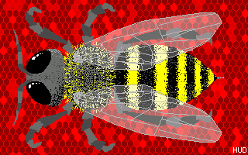
Lasar’s U2 a great
writer
With 8 EZ rules!

Slide 2
Writing is the most powerful form of multimedia ever invented
Words + your
God; cannibalism; Paris Hilton; Iraq; love; Snoop Doggy Dog; Shakespeare; mother; wuddever . . .

Slide 3
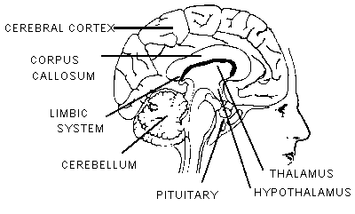
Writing is the most powerful multimedia tool ever invented
“Mrs. Daughtry walked into the living room. There on the sofa sat young Alvin the accountant, with a confident expression on his face.”
Words + your

Slide 4
Writing is the most powerful multimedia tool ever invented
“Mrs. Daughtry walked into the living room. There on the sofa sat young Lars the pool boy, with a confident expression on his face.”
Words + your

Slide 5
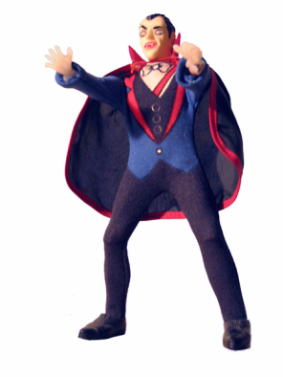
1. Don’t overuse the evil verb: iswasarewere
“is” “was” “are” “were”
Activity, not existence, defines life
Make your subjects do things

Slide 6
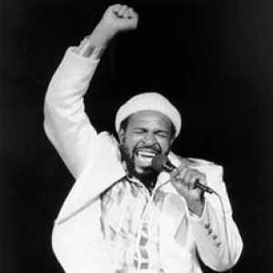
Marvin Gaye: “I heard it through the grape vine.”
Your typical UCSC student: “It was heard by me through the grape vine.”

Slide 7
Isarewaswere verbs take over your sentence and make it dull.
Passive: “Armand Anderson was a doctor who lived in Colorado. He was married to a woman whose father was a Ute trader.”
Active: “Doctor Armand Anderson practiced medicine in Colorado. He married the daughter of a Ute trader.”

Slide 8
People use passive verbs to avoid responsibility.
Oops, looks like your iPhone was lost.
Sorry, but I lost your iPhone.
Slavery was introduced in 1623 . . . [by who?]
The village was removed in 1945 . . . [by who?]
Sterilization was made mandatory in 1952 [by who?]
. . . by zombies?

Slide 9
2. Use simpler words
Why use “interrelated” or “interconnected” when you can use “related” or “connected”?
Can you tell the difference between a “diametrical opposite” and an “opposite”?
There is no such word as “irregardless.”

Slide 10
2. Use simpler words
Metropolis
City
Utilize
Use
Convivial
Cheerful
Cupidity
Protean
Insouciant

Slide 11
3. Use shorter sentences
If your sentence runs on for more than three lines the chances are that it is too long, at least that’s what I think about this aspect of writing and I’ve been doing it for a while, trust me on this, no, really.

Slide 12
4. Do not use clichés
“The café was a mecca for local artists and intellectuals.”
“It was the mother of all party battles.”
“Having spent his political capital, Grover Cleveland would now have to pay the electoral piper.”
“Descartes began to think outside the box.”

Slide 13
4b. News clichés
Game changer
Inside the beltway
Main Street versus Wall Street
He won a Hail Mary pass
She’s a maverick
Flip flop
Smear campaign
Wreaking havoc with our security
Playing political football with our future
Running neck and neck
The voters are tired of all the mud slinging
Let the healing begin

Slide 14
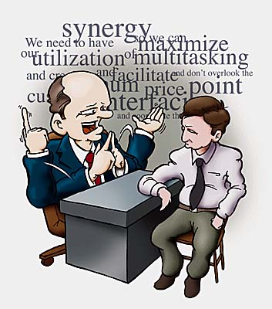
5. Avoid jargon
Problematize
Text
Binary opposition
Deconstruct
Discursive
Subjectivities
Intervention
Neoliberalism
Intersectionality
“I submit this intervention to problematize the subjectivities inherent in this text, paradigmatic of the contemporary discourse on global warming.”

Slide 15
5b. Bu$ine$$ jargon
Synergy
Monetize
Paradigm
Disruptive
Game changer

Slide 16
6. Start your essay with an interesting first sentence
No: “The economy affects our lives on a daily basis.”
Yes: “Until recently economists assumed the Crash of 1929 caused the Great Depression, but now they question that theory.”
Tell your reader something that they do not know in the first sentence

Slide 17
7. Let your reader know what you will do on the first page of your essay
“This essay will explore several New York Times articles linking typing work with women. Drawing on the scholarship of technology historians, it concludes that the typewriter did not encourage a diverse workplace. On the contrary, the machine became associated with extreme gender segmentation in the Gilded Age and Progressive Era office.”

Slide 18
Your term paper
An introductory paragraph
A description of your articles
Putting your articles in context via secondary sources
A conclusion that recapitulates your findings and reiterates your main ideas

Slide 19
Use your own words
Don’t overuse text blocks
Don’t overuse quotes
Use your own words
Use quotes for emphasis and drama

Slide 20
Great ways to get a C in this paper
Lots of spelling and grammatical errors
Don’t use page numbers
Hand it in late
Misspell my name
Misspell Kiran’s name
Misspell a book or article author’s name

Slide 21
Do not plagiarize
Do not copy without quotes.
Credit your sources in your references and text.
Always use your own words.

Slide 22
8. How to become a better writer
Write every day
Keep a diary
Start a Web log (blog)
Get friends to critique and proof your work

Slide 23
Why do people fear writing?
Afraid that they will get something wrong.
Afraid that they will write badly.
Afraid that they don’t have anything to say.

